Slide 1
UOB Models Analytic Platform RFP Proof of Concept
July 2023

Slide 2
Lineage & Data Virtualization
Functional Criteria # | Technical Criteria #
A1.1A.2 (Can the system manage metadata and lineage as data gets transformed?) | B1.3.2 (Ability to integrate with source data without requiring significant ETL work by developers. Please elaborate scenarios where development work is required for data ingestion into the platform)
A1.1A.7 (enforce or inherit data security and entitlement implemented by data source) | B1.3.6 (run customized queries to get data from the data sources)
A1.1A.8 (build data security and entitlement layer in the absence of such from the data source) | B1.3.7 (Ability to Support Federated/Unified Query to access the data from multiple data sources like DB2, Hive or Teradata)
 | B1.3.11 (query multiple data sources at the same time when designing a strategy/policy (design time)
 | B1.3.12 (query multiple data sources at the same time when executing a strategy/policy (run time)

Slide 3
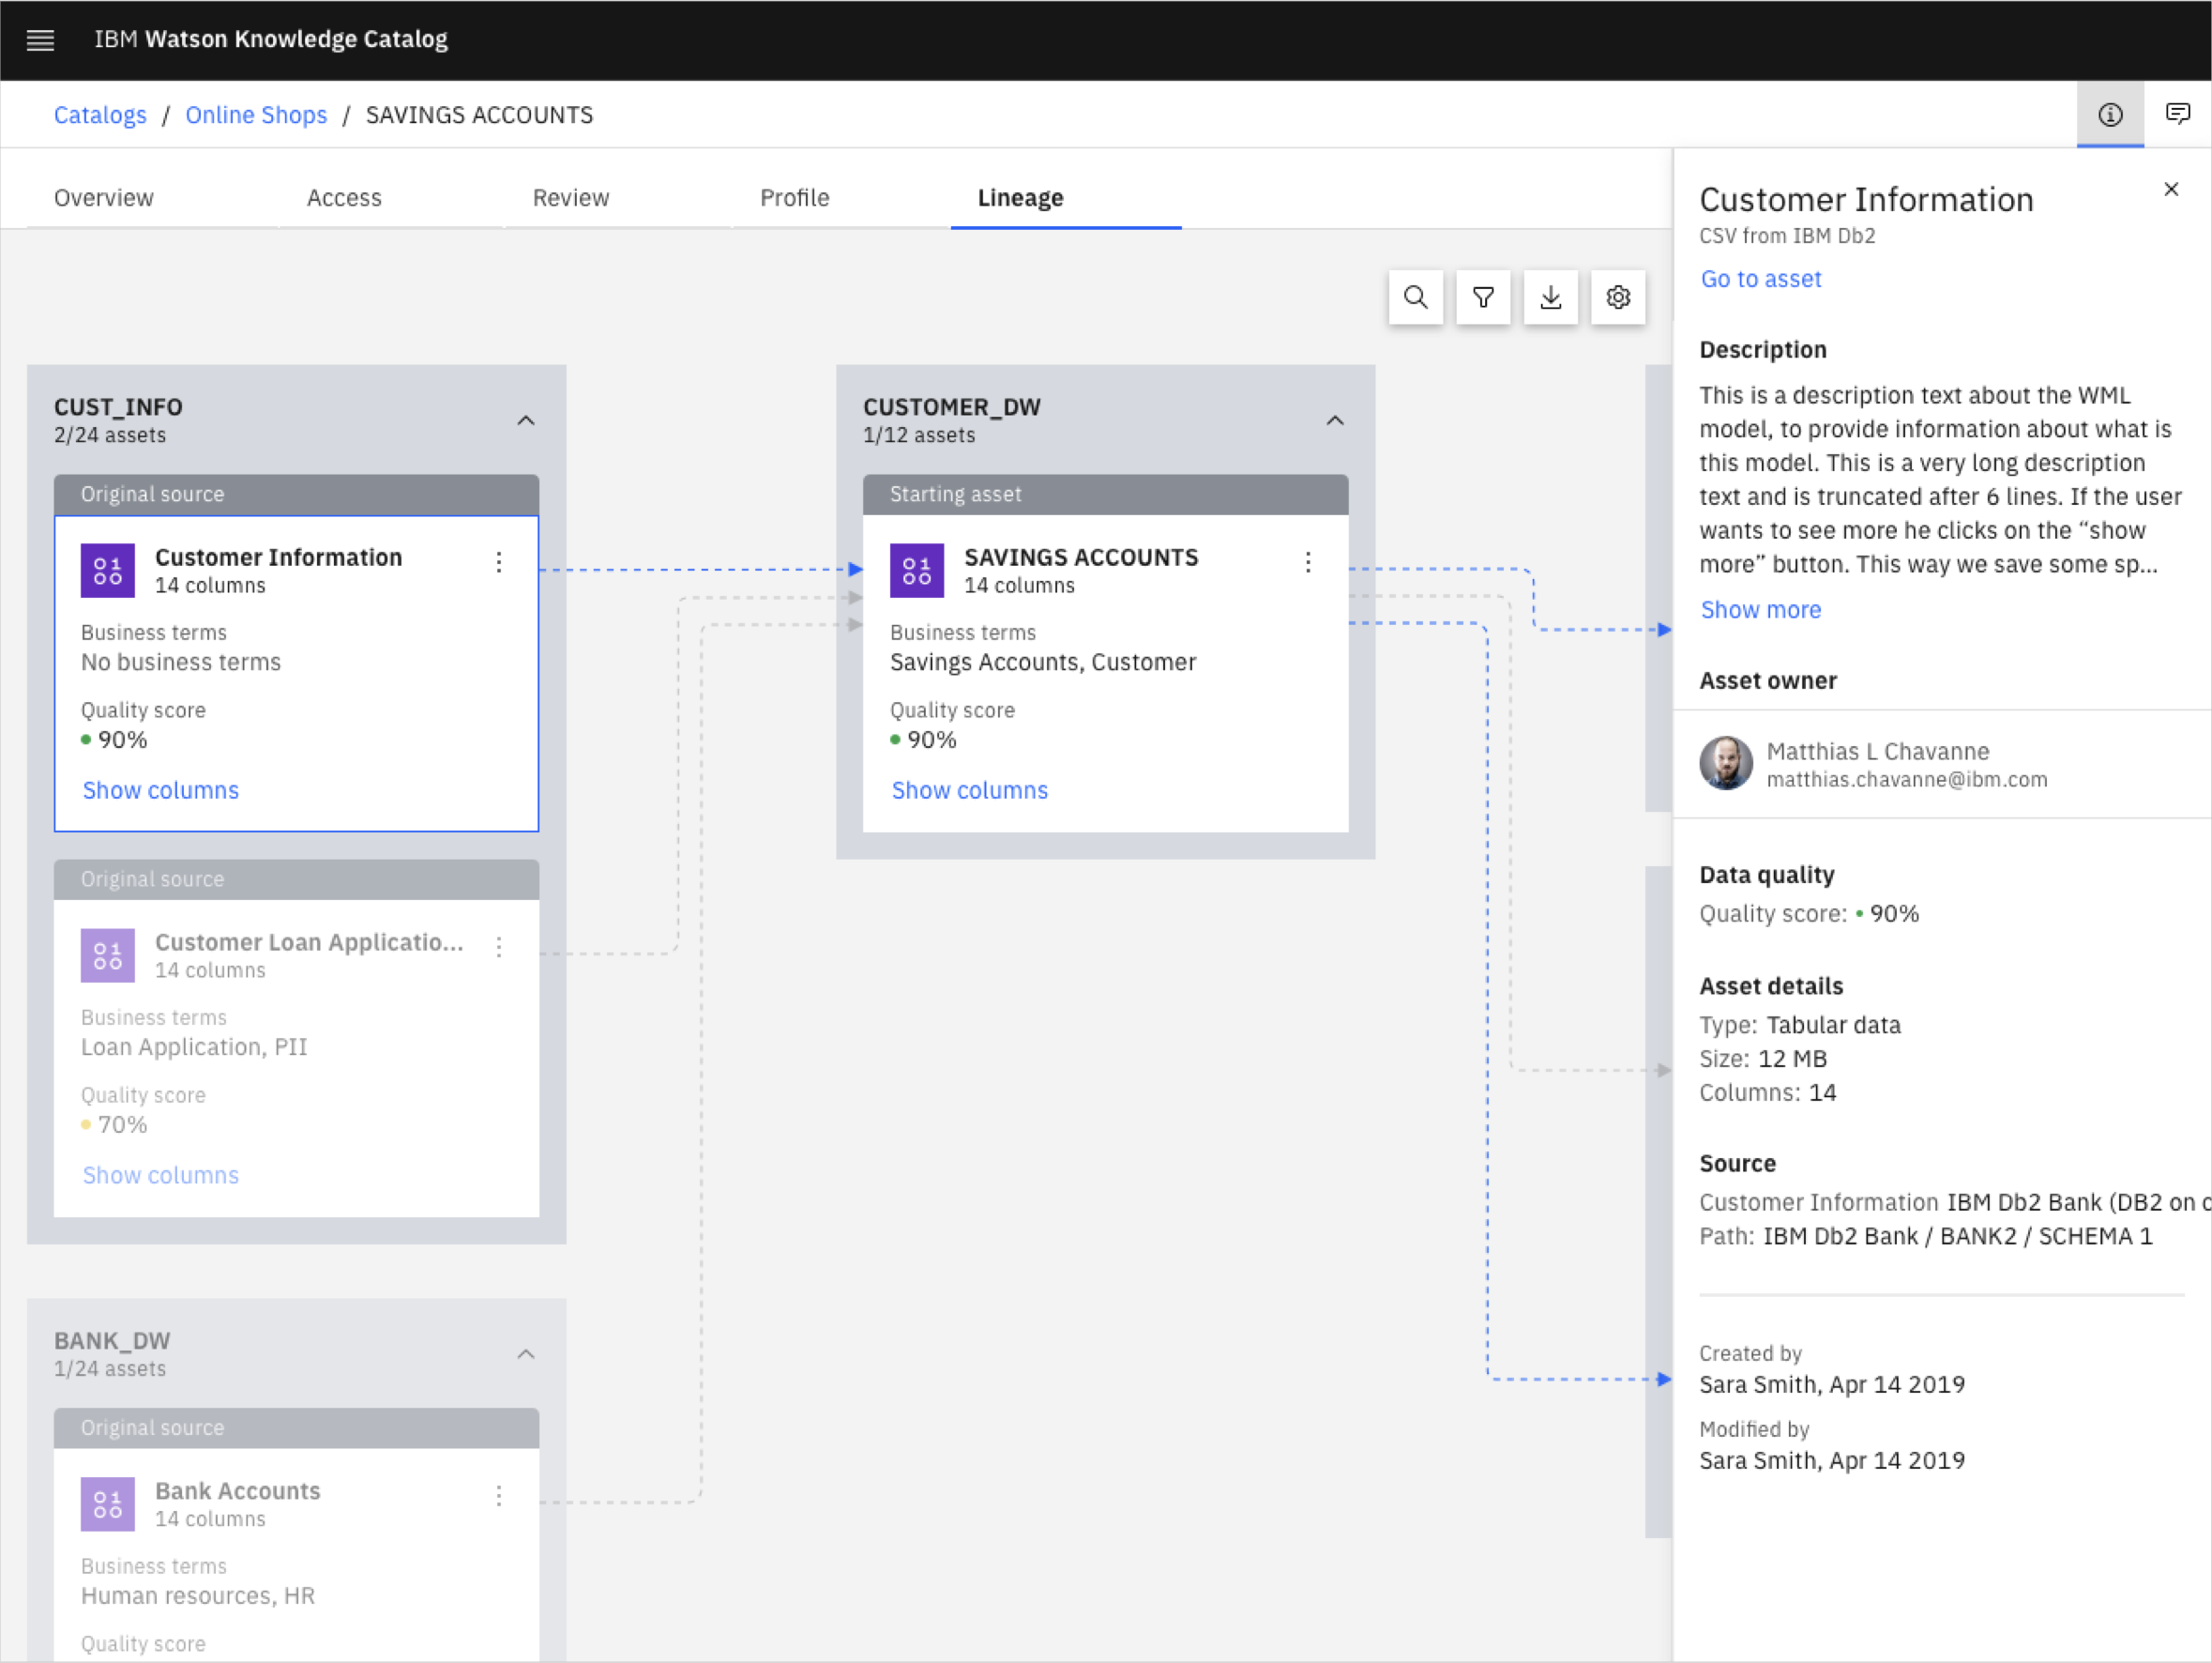
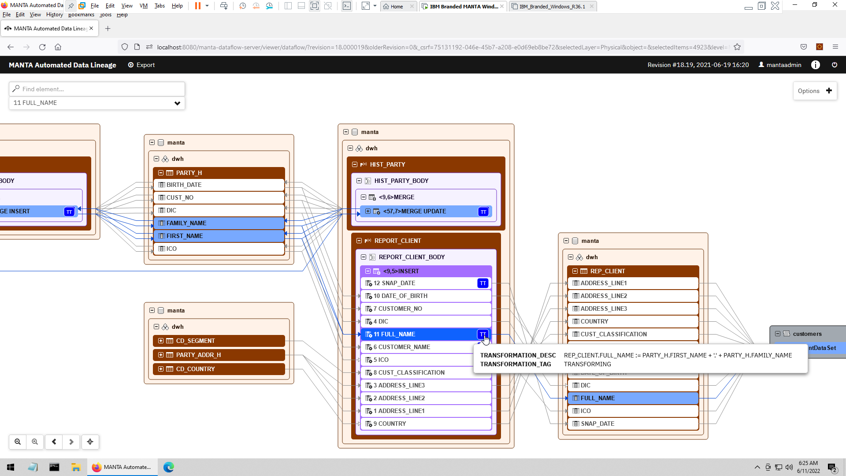
A1.1A.2: Data Lineage
Provides business-user-friendly summary view
Drill down to view technical details
Automated discovery of data flows from 3rd party tools
Code analysis of stored procedures & ETL jobs capture transformations
Manual lineage through APIs
Technical, Indirect, and Historical data lineage GUI
Rules to filter for things needed in data lineage
© 2022 IBM Corporation
3

Slide 4
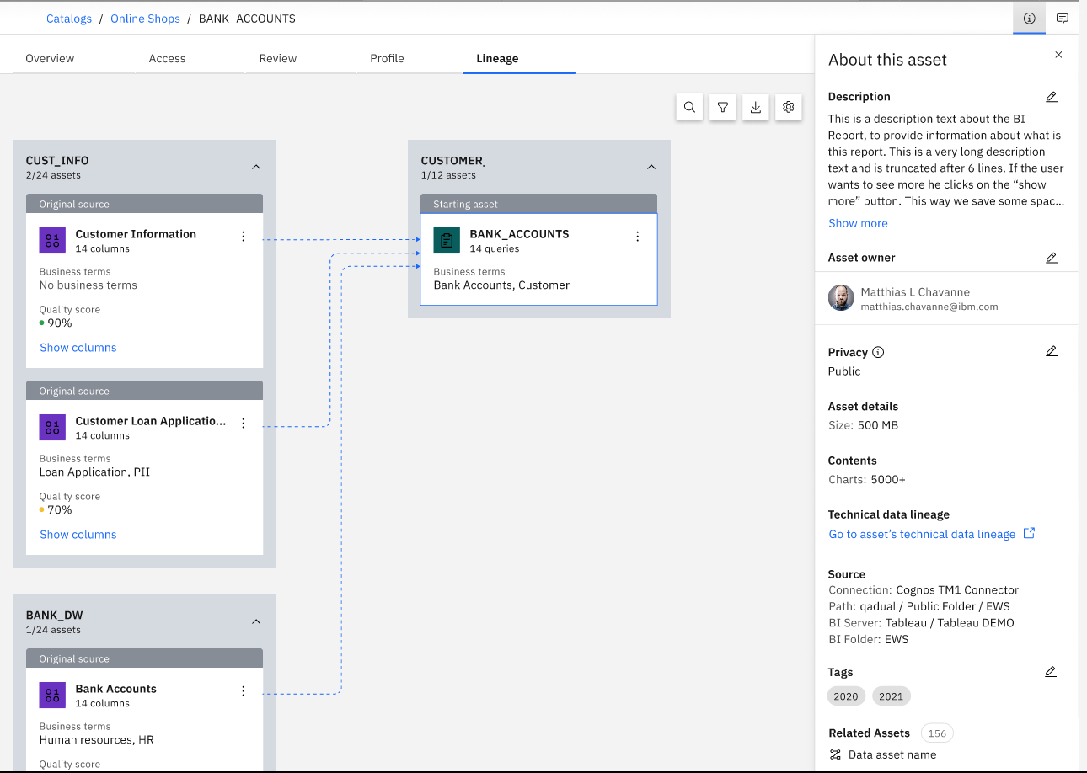
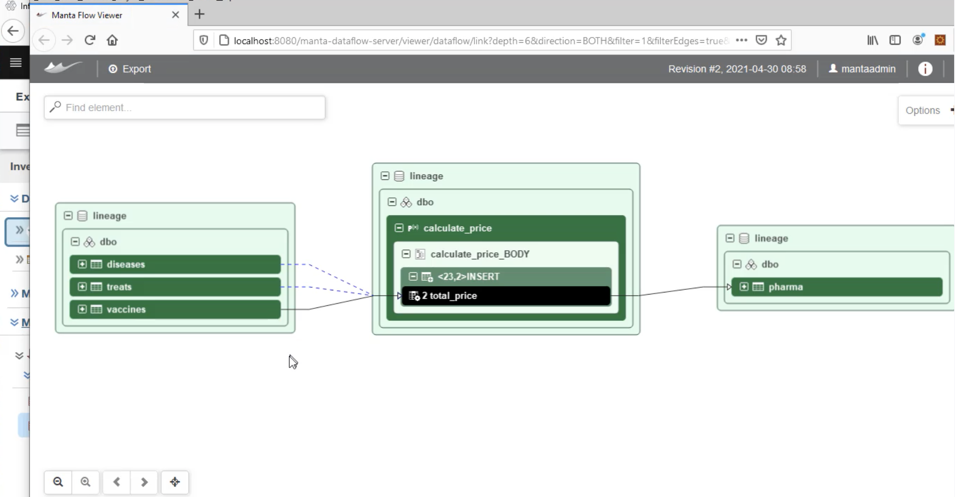
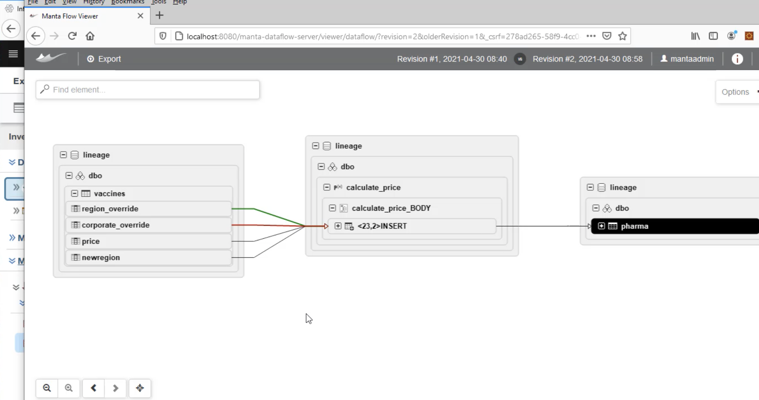
A1.1A.2 : Manta Automated Data Lineage
CPD data lineage
MANTA Automated Data Lineage Add-On
Automated discovery of data flows from 3rd party tools
Code analysis of stored procedures and ETL jobs to capture transformations
Advanced manual lineage
Technical data lineage GUI
Indirect data lineage
Historical data lineage
Rules to filter for things needed in data lineage
1
2
Scanned assets are stored in WKC catalogs and visible through native UI
Technical data lineage
3
Option to view additional lineage details
CPD Data Lineage
View lineage graph via WKC UI
REST APIs to capture lineage info
Import/export lineage through CSV
Automatically captures data flows from the CP4D platform
Models from Auto AI
Data Virtualization
Next Gen DataStage Jobs
Data Refinery
Advanced Data Privacy
Historical data lineage
© 2022 IBM Corporation
4

Slide 5
Supported Scanners
Databases
Yellowbrick
Amazon RDS for PostreSQL
Amazon Redshift
Amazon Aurora
Google Big Query
Snowflake
Greenplum
Hive (Apache)
IBM Db2
Microsoft Azure SQL Data Warehouse
Microsoft Azure SQL Managed Instance
Microsoft SQL Server Database
Netezza
PostgreSQL
SAP ASE (Sybase)
SAP Hana
Teradata Database
Oracle
Amazon S3
Data integration
Apache Kafka
Infosphere DataStage
Informatica Power Center
Microsoft SQL Server Integration Services
Oracle Data Integrator
Pig
Sqoop
StreamSets
Talend
Azure Data Factory
Next Gen Data Stage
Fivetran
DBT
Programming languages
COBOL
Note:
Scanners not on this list can be supported through either MANTA’s Advanced Manual Lineage or through IBM Business Data Lineage’s native Manual Lineage Capabilities
Reporting & Analysis
Qlik Sense
Cognos
Microsoft Excel
Microsoft SQL Analytics Platform System
Microsoft SQL Server Analysis Services
Microsoft SQL Server Reporting Services
Oracle Business Intelligence (OBIEE)
Power BI
SAP Business Objects
SAS
Tableau
Modeling
ER/Studio
Erwin Data Modeler
SAP Power Designer
© 2023 IBM Corporation
5

Slide 6



A1.1A.7, A1.1A.8, B1.3.7, B1.3.11 & B1.3.12: What is Data Virtualization
Data virtualization enables access to physical data from various sources, in a virtual manner, so that the data can be accessed, manipulated, and analyzed, without needing to know its physical format or location, and without having to move or copy it.
Connect, access, and govern any data without the need for data movement
Access structured and unstructured disparate data on demand, without the need for ETL or creation of copies.
Abstract complexity from data consumers
A virtual semantic layer across all your data sources allows users to quickly connect to, join, and analyze data from multiple sources without needing to understand back-end database technologies.
Create virtual views over multiple data sources
No need for transformations; create a virtual view of required data that can be shared within your organization.
Governance integration and security
Controlled, governed and secure access to virtual data sets through native integration with Watson Knowledge Catalog.
Appears as if all tables are in the same database
Virtual Tables represent the physical data
Physical Tables

Slide 7
A1.1A.7, A1.1A.8, B1.3.7, B1.3.11 & B1.3.12: What is IBM Watson Query
A universal data access layer that automates how you access and unify data across any source or type (clouds, warehouses, lakes, etc.) with data virtualization, without the need for data movement or replication
Watson Query Experience
Data Science
Business Intelligence
AI Apps
One query experience over multiple data sources, types, and form factors
Integrated governance with Watson Knowledge Catalog to provide governed data access
Open data formats to work with data on any cloud and on-premises (Parquet, Orc, CSV, TSV)
Real-time data integration without data movement
Intelligent cache recommendation accelerating query performance with minimal user input
Unified Ops
Self-Service
End-to-end Governance, Security, Compliance
IBM Watson Query
Virtual Tables
Connection Layer
Data Sources
COS
Blob Storage
Cloud Storge
S3
Db2
Netezza
Teradata
IBM Cloud
Cloudera
Azure
GCP
AWS
Snowflake
Oracle
… and more!
Cloud Data Lake
Database and Warehouse
Any Data, Anywhere.

Slide 8
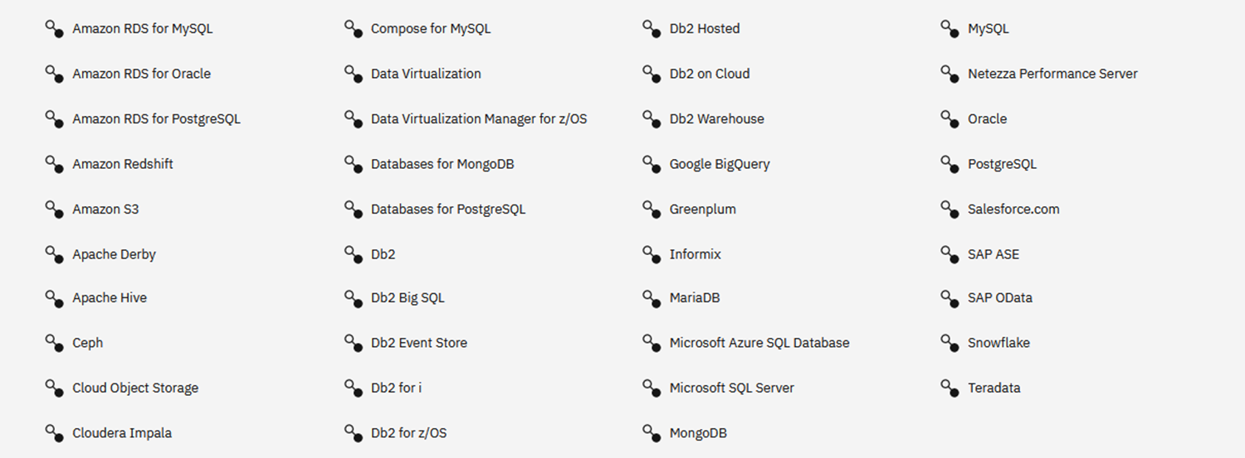
B1.3.7, B1.3.11 & B1.3.12 : Broad support for Data Sources
New sources continually added!

Slide 9
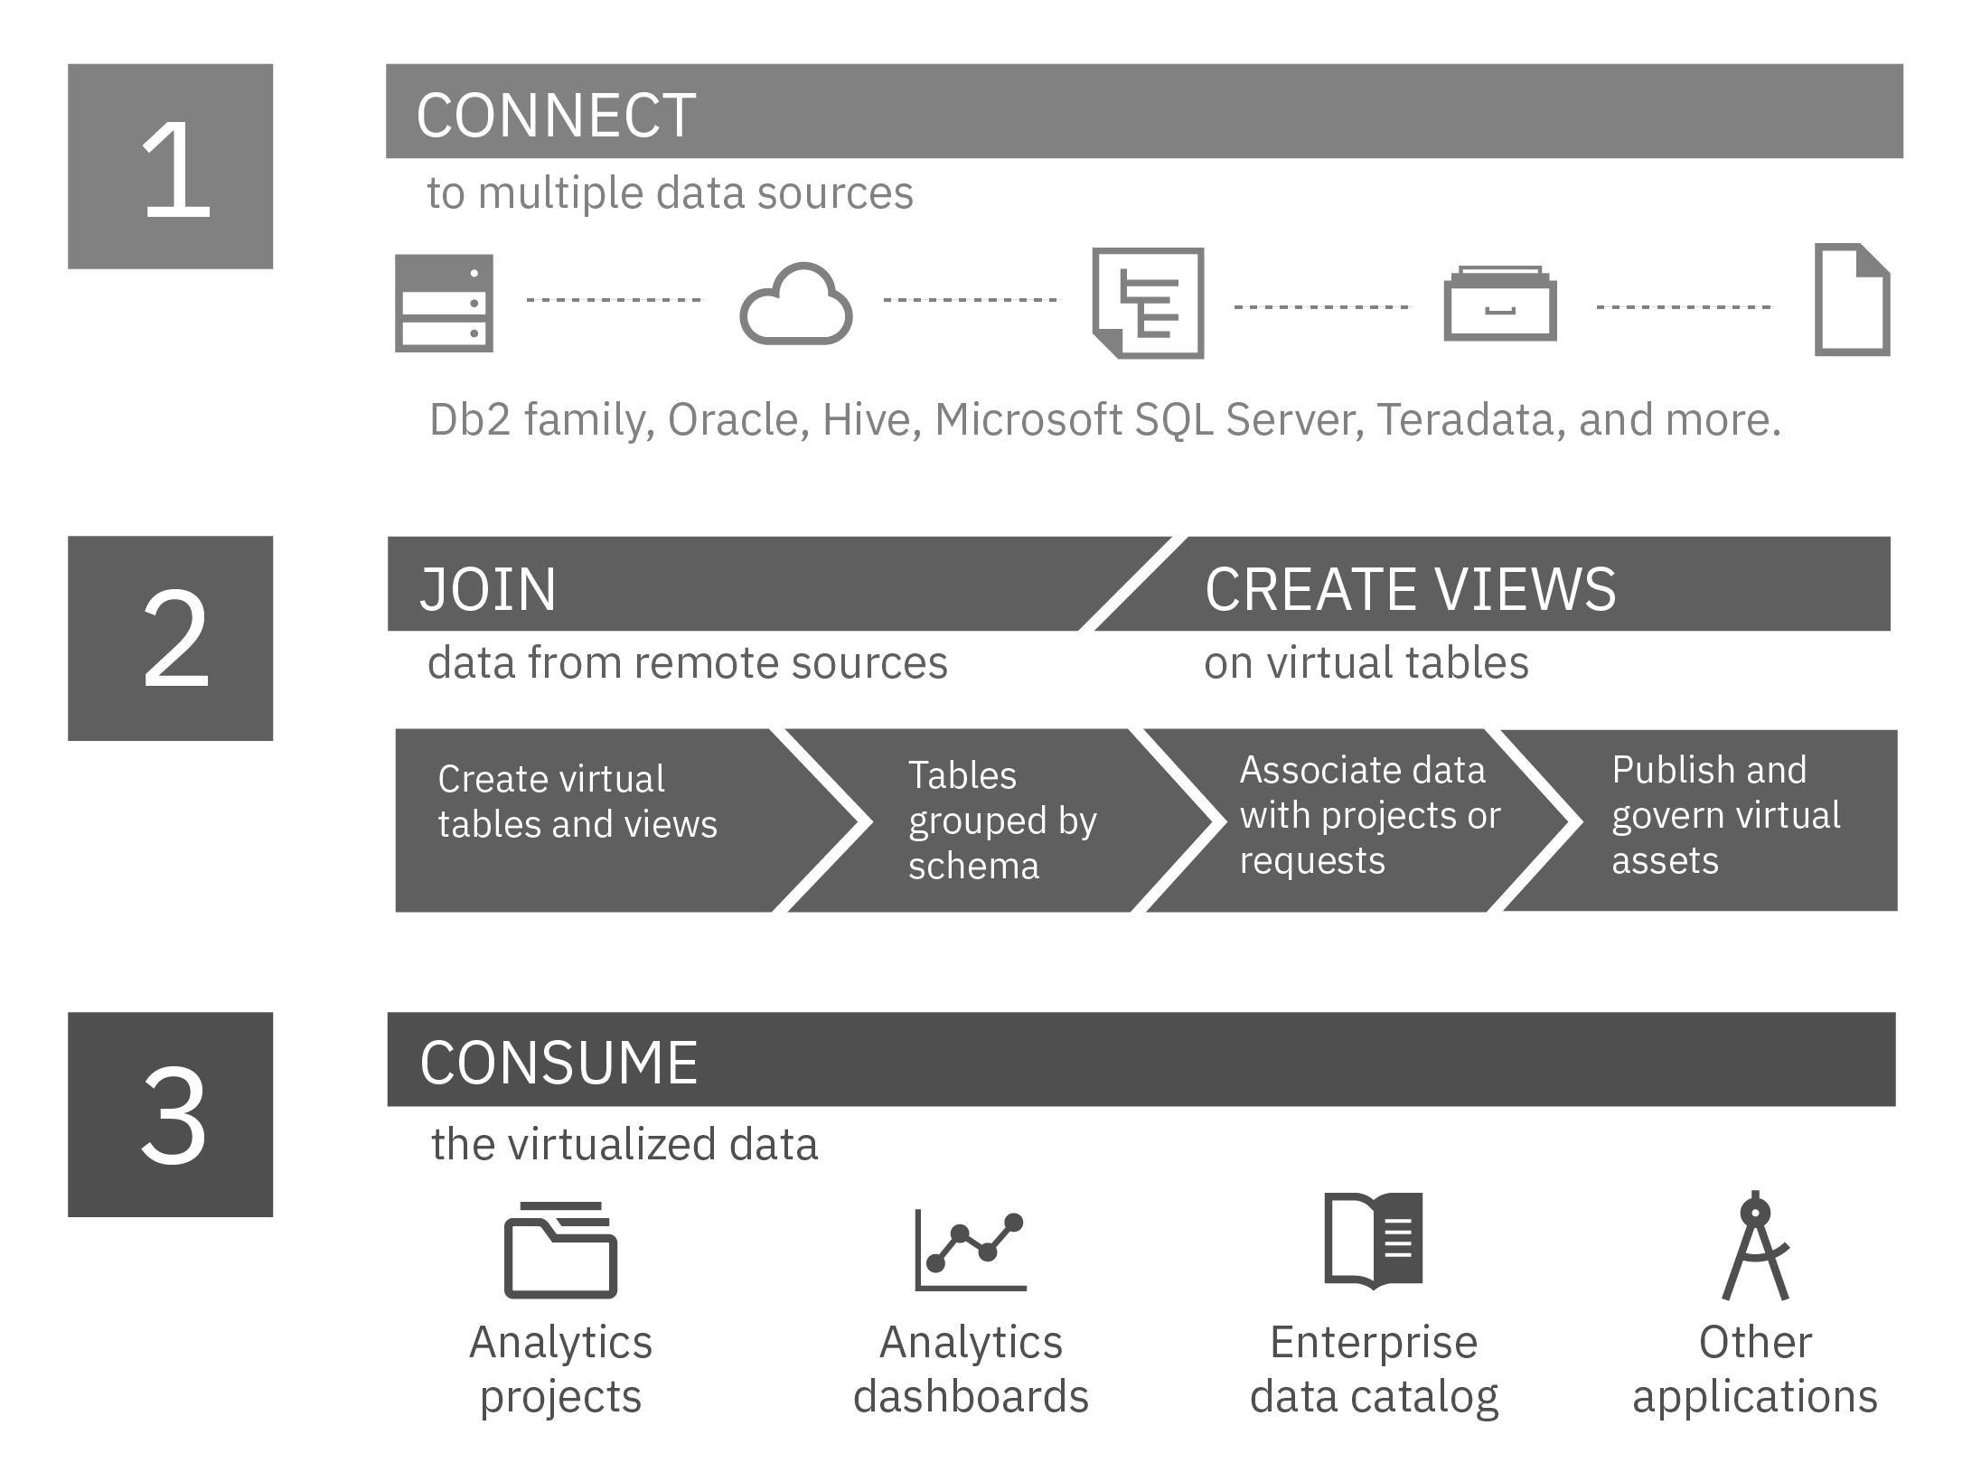
B1.3.3 About Watson Query
Size limits: Watson Query supports virtualization of tables with a row size up to 1 MB, and up to 2048 columns in a table. However, the number of columns that Watson Query can preview depends on many factors, such as the data types of the columns. Currently, preview is limited to 200 columns.
File formats: Watson Query supports PARQUET (or PARQUETFILE), ORC (optimized row columnar), CSV (comma-separated values), TSV (tab-separated values), and JSON file formats. Metadata is extracted from the data file.
For CSV and TSV files: Cloud Pak for Data automatically detects the encoding scheme of flat data files, such as CSV and TSV files.
https://www.ibm.com/docs/en/cloud-paks/cp-data/4.6.x?topic=connectors-setting-character-encoding-scheme

Slide 10
Data Virtualization
Functional Criteria # |  | Technical Criteria #
A1.1A.2 (Can the system manage metadata and lineage as data gets transformed?) |  | B1.3.2 (Ability to integrate with source data without requiring significant ETL work by developers. Please elaborate scenarios where development work is required for data ingestion into the platform)
A1.1A.7 (enforce or inherit data security and entitlement implemented by data source) |  | B1.3.6 (run customized queries to get data from the data sources)
A1.1A.8 (build data security and entitlement layer in the absence of such from the data source) |  | (B1.3.7) Ability to Support Federated/Unified Query to access the data from multiple data sources like DB2, Hive or Teradata
 |  | B1.3.11 (query multiple data sources at the same time when designing a strategy/policy (design time)
 |  | B1.3.12 (query multiple data sources at the same time when executing a strategy/policy (run time)

Slide 11
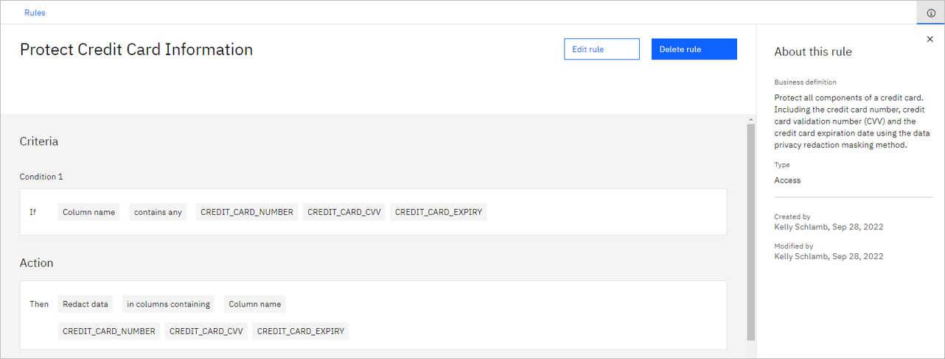
Data Virtualization – Rule created

Slide 12
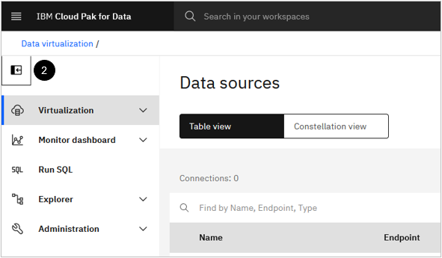
Data Virtualization -Governance
Data > Data virtualization.
Administration > Service settings
Select Governance tab
Toggle the Enforce policies within Data Virtualization switch to On. Toggle the Enforce publishing to a governed catalog switch to On.

Slide 13
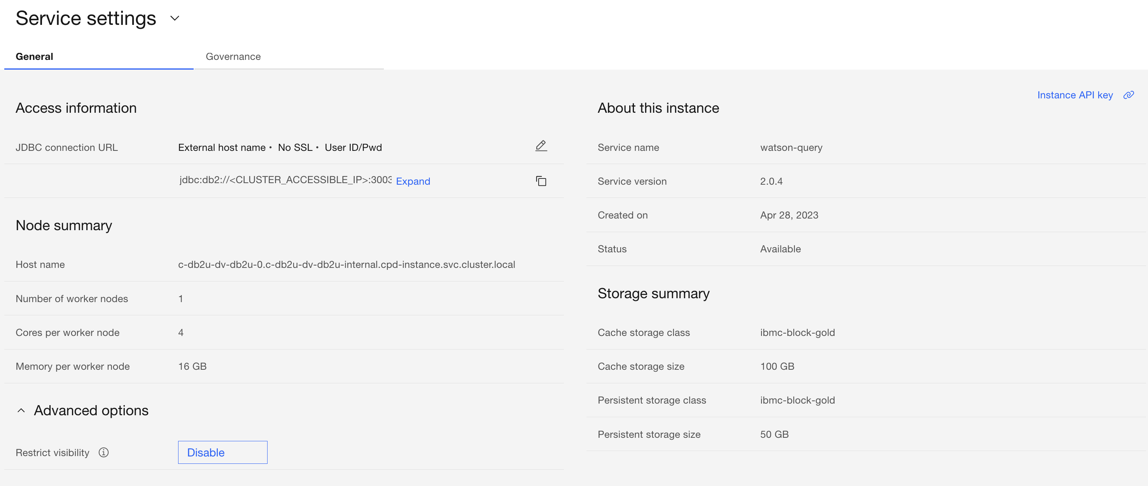
Storage details

Slide 14
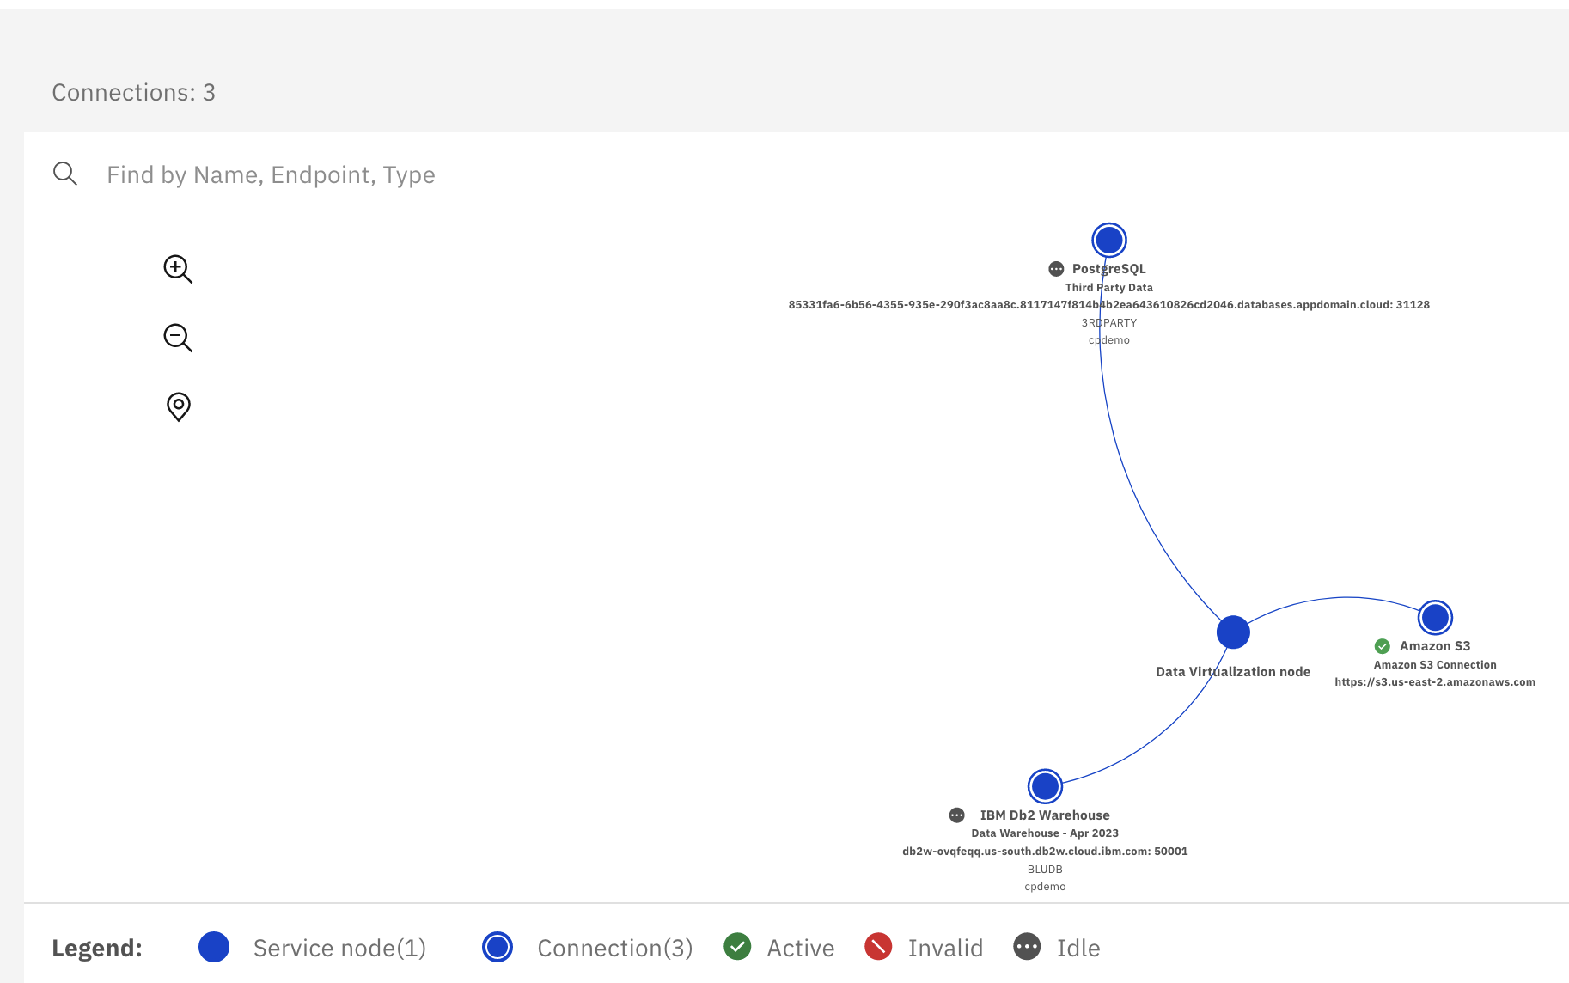
Define Data Sources
Select Virtualization > Data sources from the side menu. Click Add connection + in the upper-right corner and then select Existing platform connection.
When prompted with the Confirm to continue pop-up message, click Confirm.
Select the radio button for the Data Warehouse (IBM Db2 Warehouse) connection.
Click Add. Data sources:
Show PostgreSQL Data Source
Show Amazon S3 Data Source
Show constellation view
A remote connector enables the virtualization of data that is stored on a file system or a remote data source that is not directly accessible by Watson Query.

Slide 15
Virtualize data
Rather than you manually searching through the database data source – looking for tables across the many schemas in a Db2 or Oracle database, for instance – it will automatically scan the database (based on the permissions of the user used for the connection) and present the data objects found to you. You can then choose to create virtual tables as needed, based on the objects listed.
Select Virtualization > Virtualize from the side menu. Click list
Hundreds of tables are listed. Where did all these tables come from? Watson Query discovered them from your database connections!
In the Filter by bar, click on the Source type, Database, and Schema dropdown selection menus to get a feel for the type of filtering that can be done.
In the Find tables by name, schema, column, or business term search field, enter CUSTOMER.
Check the boxes for both the CUSTOMER and CUSTOMER_LOYALTY tables.
Note: The auto-discovery operation may take a minute or two to complete and so you might not see both of these tables listed initially. You may also see pop-up messages saying things like "Tables were added or updated. Click Reload to load the tables." and "All listed tables are loaded: Click Refresh to update the list." Click to reload and refresh as needed and both of these tables should eventually show up.
Click Add to cart.
Click View cart (2) (the “2” represents the two tables that you added to the cart) to advance to the Review cart and virtualize tables page.
Watson Query gives clients the flexibility to customize virtual tables based on their needs. For example, on this Review cart and virtualize tables page, you can choose to rename the schema and/or table names, as well as remove columns or change the name and type of columns within the tables. For this lab, leave the schema and table names as they are. The source of the schema name (which is unique to you) will be explained later in the lab.

Slide 16
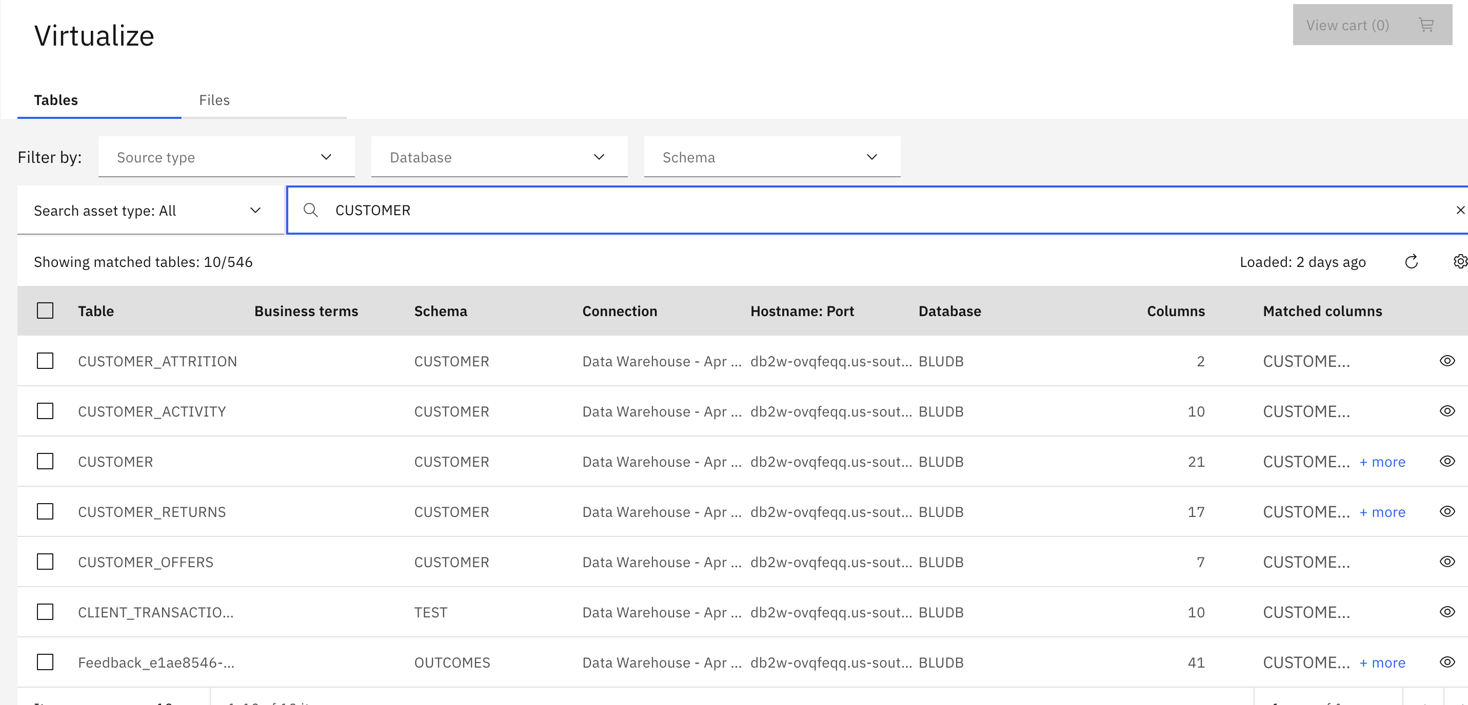
Virtualize data
CUSTOMER: Main customer details, including name, address, and credit card information. This table is hosted in a Db2 Warehouse relational database.
CUSTOMER_LOYALTY: Customer loyalty and sales information from 2016 onward. This table is hosted in a PostgreSQL relational database.
CUSTOMER_LOYALTY_HISTORY: Archived customer loyalty information from 2010-2015. This data is stored in a CSV file on Amazon S3 object storage.
Select Virtualization > Virtualize from the side menu.
In the Find tables by name, schema, column, or business term search field, enter CUSTOMER.
Check the boxes for both the CUSTOMER and CUSTOMER_LOYALTY tables.
Click Add to cart.
Click View cart (2) (the “2” represents the two tables that you added to the cart) to advance to the Review cart and virtualize tables page.
Within the Objects to be virtualized section, click the vertical ellipsis at the right side of the row for the CUSTOMER table and select Edit columns.
Uncheck the rows associated with the GENDER and EDUCATION columns (these columns were chosen arbitrarily, simply as an example of how to do this).
Click the Apply button in the upper-right corner.
Unselect the Assign to project check box. By doing this, the table won't be added to any project, but it will be available in the Virtualized data section of the console (which you will see later).
Click the Virtualize button in the upper-right corner.
The virtualization process has started for the CUSTOMER and CUSTOMER_LOYALTY tables. Click Virtualize more data.

Slide 17
Virtualizing Data from Object Storage Files
For files located in object storage, you start by selecting the endpoint URL and then work your way through the bucket and any folders as needed to locate the file(s) you want to virtualize as a table in Watson Query.
Select the Files tab.
Click the https://s3.us-east-2.amazonaws.com endpoint URL link
Select the cpd-outcomes-s3 bucket on the left
Select the Customer folder.
Select CUSTOMER_LOYALTY_HISTORY.csv.
Click Add to cart.
Click View cart (1).
Unselect the Assign to project check box. By doing this, the table won't be added to any project, but it will be available in the Virtualized data section of the console (which you will see later).
Change the table name from CUSTOMER_LOYALTY_HISTORY_csv to CUSTOMER_LOYALTY_HISTORY.
Click the vertical ellipsis at the right side of the row for the CUSTOMER_LOYALTY_HISTORY table and select Edit columns.

Slide 18
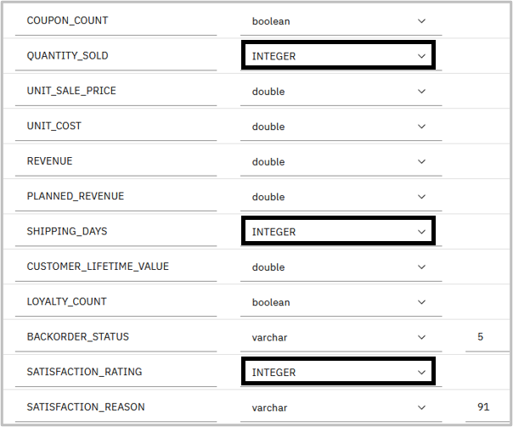
Virtualizing Data from Object Storage Files
Click the vertical ellipsis at the right side of the row for the CUSTOMER_LOYALTY_HISTORY table and select Edit columns.

Slide 19
Virtualizing Data from Object Storage Files
When profiling the data, three columns may incorrectly be assigned the wrong type. Make the following changes to the columns listed (if they are not already assigned the Int (integer) type):
QUANTITY_SOLD: Change type to INTEGER
SHIPPING_DAYS: Change type to INTEGER
SATISFACTION_RATING: Change type to INTEGER
Scroll up and click the Apply button in the upper-right corner.
Back on the Review cart and virtualize tables screen, click the Virtualize button in the upper-right.
14. The virtualization process has started for the CUSTOMER_LOYALTY_HISTORY table. Click Go to virtualized data.
The three tables are now available for access through Watson Query (and have been published to the catalog). Virtual views can also be created "on top of" the virtual tables.

Slide 20
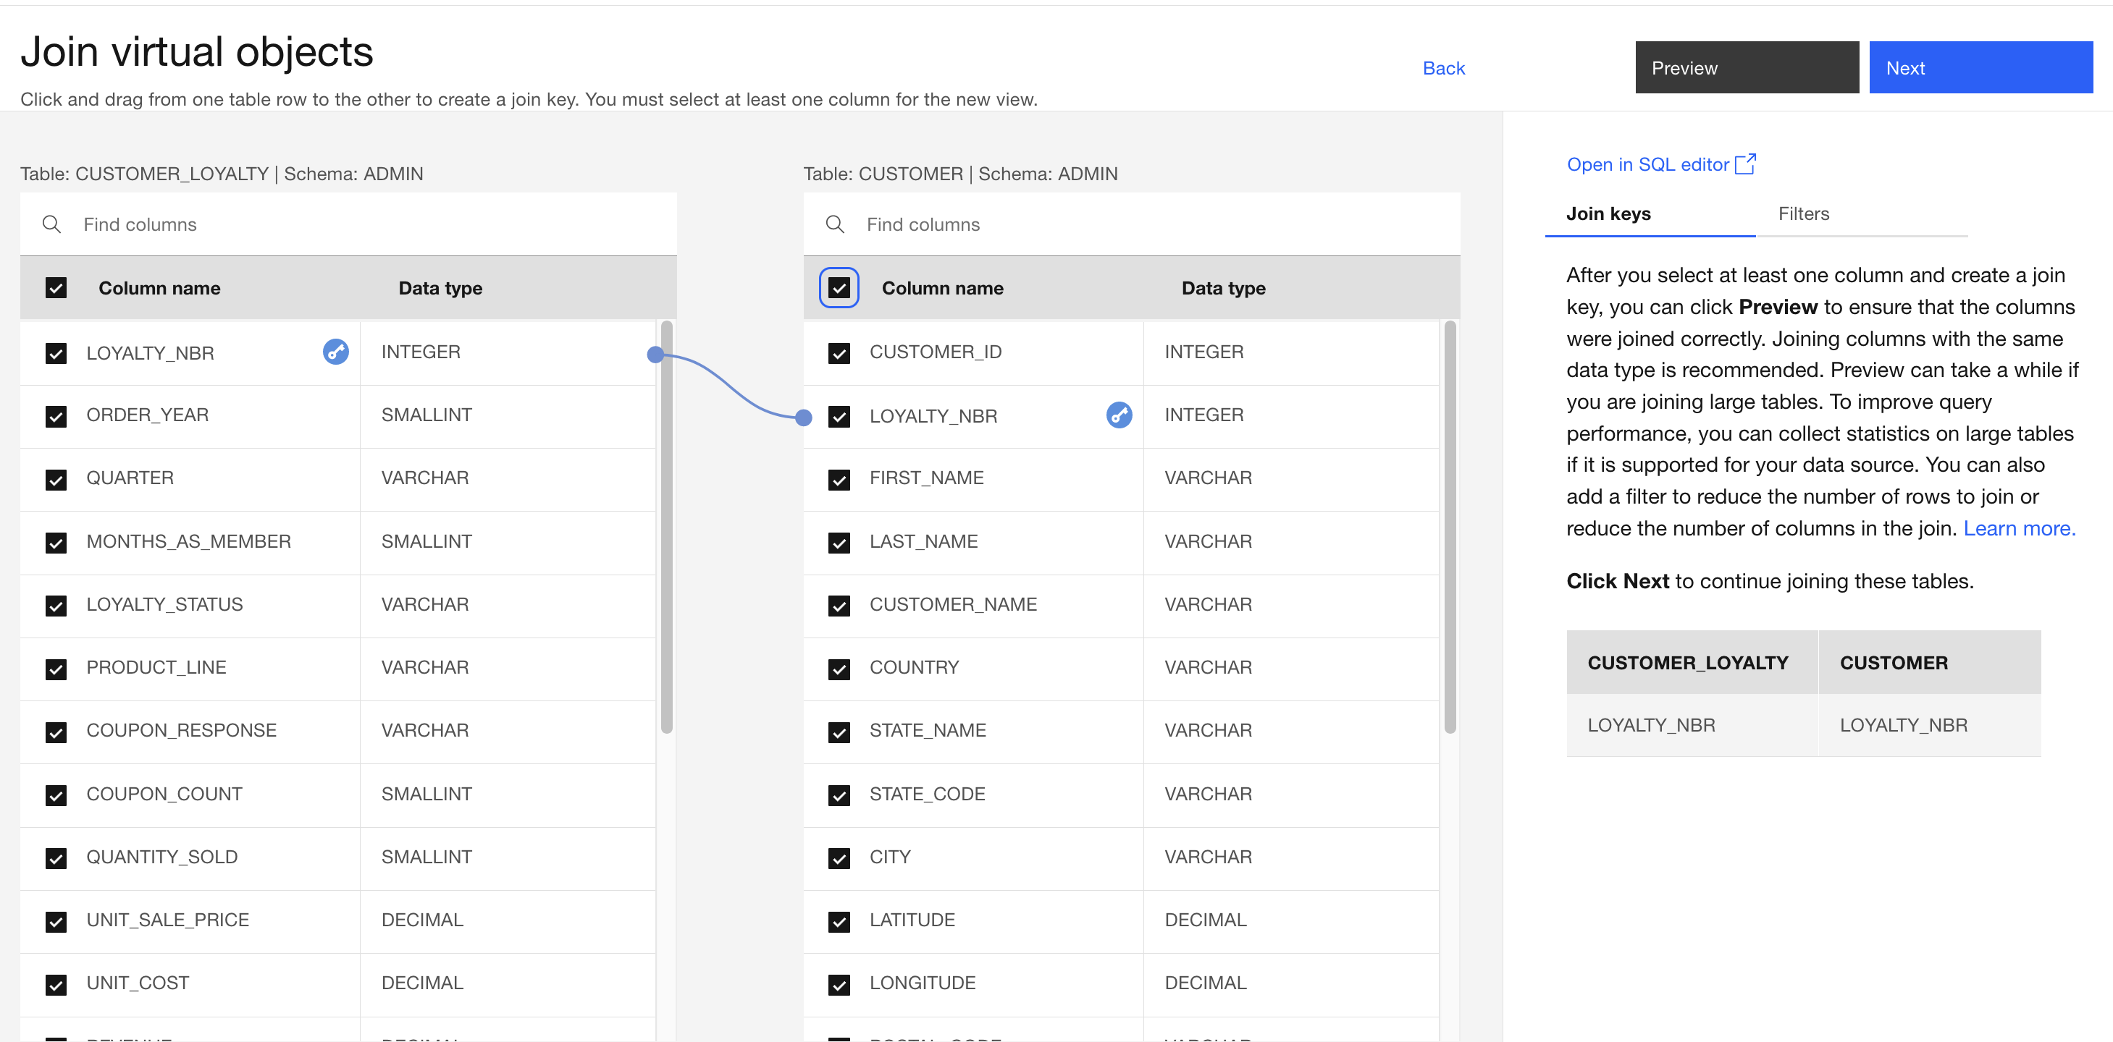
Create Virtual Views
In Watson Query, there are two options available for creating a view that joins tables (or other views) together. One approach is to use the graphical interface and the other is to create it manually by running a CREATE VIEW SQL statement. The graphical approach is very simple and intuitive, whereas the SQL approach is more flexible. A SQL statement allows for very specific filtering, the ability to join more than two tables at once, and more choices on the type of join used (inner join, left outer join, right outer join, full outer join, and so on).
Check the boxes for both the CUSTOMER and CUSTOMER_LOYALTY tables.
Click Join on the right.
Select the check box in the Column name header for the table on the left (which will select every column in the table).
Select the check box in the Column name header for the table on the right (which will select every column in the table).
Put your cursor focus on the LOYALTY_NBR row in the table on the left and click on it, without releasing the mouse button (nothing will happen yet).
Holding the mouse button down, drag the connection line that appears when you start moving the cursor...
... and connect the line to the LOYALTY_NBR row of the table on the right.
A blue line will appear, connecting these two columns as the join key. Note the key icons that appear – they indicate that the join key is comprised of the LOYALTY_NBR columns in the two tables.

Slide 21
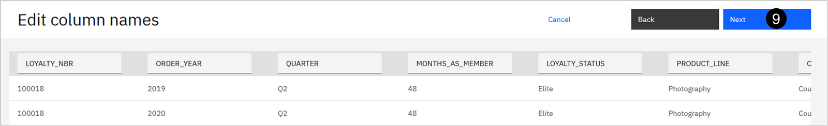
This screen allows you to modify the column names, but don’t modify any of them. Click Next

Slide 22
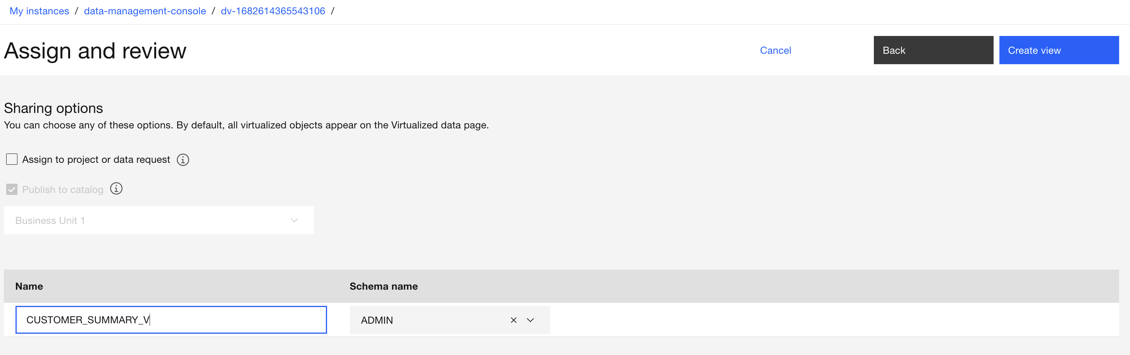
Create Virtual Views
Unselect the Assign to project check box. By doing this, the view won't be added to any project, but it will be available in the Virtualized data section of the console (which you will see later).
Enter CUSTOMER_SUMMARY_V for the View name. (Duplication checking is performed as you type and if you see a message stating that the view name already exists, finish typing and wait for the message to disappear.)

Slide 23
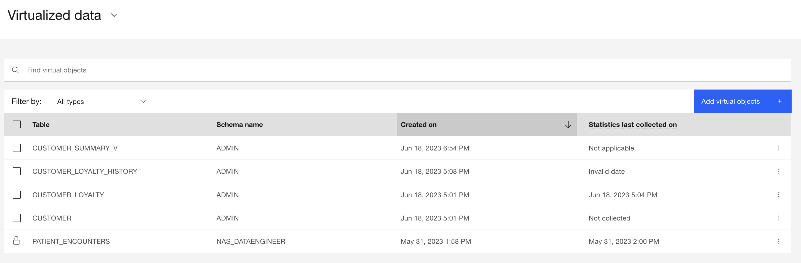
Create Virtual Views
The view has been created successfully.
Click Go to virtualized data.
You should see the CUSTOMER_SUMMARY_V view in your list of virtualized data objects. Next, you will create a view by specifying a SQL statement.

Slide 24
Create Virtual Views
Note: The order of the two tables that you see might not match the image above (CUSTOMER might be on the left with CUSTOMER_LOYALTY on the right). That is okay as the instructions below still apply.
Like you did earlier, check the boxes for both the CUSTOMER and CUSTOMER_LOYALTY tables.
Click Join on the right.
Select the check box in the Column name header for the table on the left (which will select every column in the table).
Select the check box in the Column name header for the table on the right (which will select every column in the table).
Put your cursor focus on the LOYALTY_NBR row in the table on the left and click on it, without releasing the mouse button (nothing will happen yet).
Holding the mouse button down, drag the connection line that appears when you start moving the cursor...
... and connect the line to the LOYALTY_NBR row of the table on the right.
A blue line will appear, connecting these two columns as the join key. Note the key icons that appear – they indicate that the join key is comprised of the LOYALTY_NBR columns in the two tables.
You are about to provide your own definition for the view, so why do this work to specify the columns to include and the join key here? The console doesn't permit you to click the Open in SQL editor link until you've done this. Generally, you would use this approach to construct the view as much as possible with the graphical interface and then tweak the final definition using the editor.
Click Open in SQL editor.
When warned about returning to the Join virtual objects page after creating the view through SQL, click Continue.
A CREATE VIEW SQL statement is pre-populated in the SQL Editor. The view definition includes the columns you selected from the tables on the previous screen, along with the join key you specified.
At this point you can modify the pre-populated statement or completely replace it with your own statement. If your intention is to create a view that you otherwise could have created using the graphical approach, but there was logic or behavior you couldn’t specify – such as a specific type of join – then you would want to use this combined approach. In that case, do exactly what you did here to specify the columns involved and the join key and then tweak the statement as needed in the SQL Editor before running it.
If you have a CREATE VIEW statement designed already (like in this example) then you also have the option of running it in the Run SQL section of the console (which you will experience later) or using a 3rd party SQL editor connected into the environment.

Slide 25
Create Virtual Views
Replace the pre-populated CREATE VIEW statement with the statement below:
CREATE VIEW CUSTOMER_SUMMARY_V2 AS
SELECT CUSTOMER.CUSTOMER_ID AS CUSTOMER_ID, CUSTOMER.LOYALTY_NBR AS LOYALTY_NBR, CUSTOMER.FIRST_NAME AS FIRST_NAME,
CUSTOMER.LAST_NAME AS LAST_NAME, CUSTOMER.CUSTOMER_NAME AS CUSTOMER_NAME, CUSTOMER.COUNTRY AS COUNTRY,
CUSTOMER.STATE_NAME AS STATE_NAME, CUSTOMER.STATE_CODE AS STATE_CODE, CUSTOMER.CITY AS CITY,
CUSTOMER.LATITUDE AS LATITUDE, CUSTOMER.LONGITUDE AS LONGITUDE, CUSTOMER.POSTAL_CODE AS POSTAL_CODE,
CUSTOMER.LOCATION_CODE AS LOCATION_CODE, CUSTOMER.INCOME AS INCOME, CUSTOMER.MARITAL_STATUS AS MARITAL_STATUS,
CUSTOMER.CREDIT_CARD_TYPE AS CREDIT_CARD_TYPE, CUSTOMER.CREDIT_CARD_NUMBER AS CREDIT_CARD_NUMBER,
CUSTOMER.CREDIT_CARD_CVV AS CREDIT_CARD_CVV, CUSTOMER.CREDIT_CARD_EXPIRY AS CREDIT_CARD_EXPIRY,
CUSTOMER_LOYALTY.ORDER_YEAR AS ORDER_YEAR, CUSTOMER_LOYALTY.QUARTER AS QUARTER,
CUSTOMER_LOYALTY.MONTHS_AS_MEMBER AS MONTHS_AS_MEMBER, CUSTOMER_LOYALTY.LOYALTY_STATUS AS LOYALTY_STATUS,
CUSTOMER_LOYALTY.PRODUCT_LINE AS PRODUCT_LINE, CUSTOMER_LOYALTY.COUPON_RESPONSE AS COUPON_RESPONSE,
CUSTOMER_LOYALTY.COUPON_COUNT AS COUPON_COUNT, CUSTOMER_LOYALTY.QUANTITY_SOLD AS QUANTITY_SOLD,
CUSTOMER_LOYALTY.UNIT_SALE_PRICE AS UNIT_SALE_PRICE, CUSTOMER_LOYALTY.UNIT_COST AS UNIT_COST,
CUSTOMER_LOYALTY.REVENUE AS REVENUE, CUSTOMER_LOYALTY.PLANNED_REVENUE AS PLANNED_REVENUE,
CUSTOMER_LOYALTY.SHIPPING_DAYS AS SHIPPING_DAYS, CUSTOMER_LOYALTY.CUSTOMER_LIFETIME_VALUE AS CUSTOMER_LIFETIME_VALUE,
CUSTOMER_LOYALTY.LOYALTY_COUNT AS LOYALTY_COUNT, CUSTOMER_LOYALTY.BACKORDER_STATUS AS BACKORDER_STATUS,
CUSTOMER_LOYALTY.SATISFACTION_RATING AS SATISFACTION_RATING, CUSTOMER_LOYALTY.SATISFACTION_REASON AS SATISFACTION_REASON
FROM CUSTOMER, CUSTOMER_LOYALTY
WHERE CUSTOMER.LOYALTY_NBR=CUSTOMER_LOYALTY.LOYALTY_NBR;

Slide 26
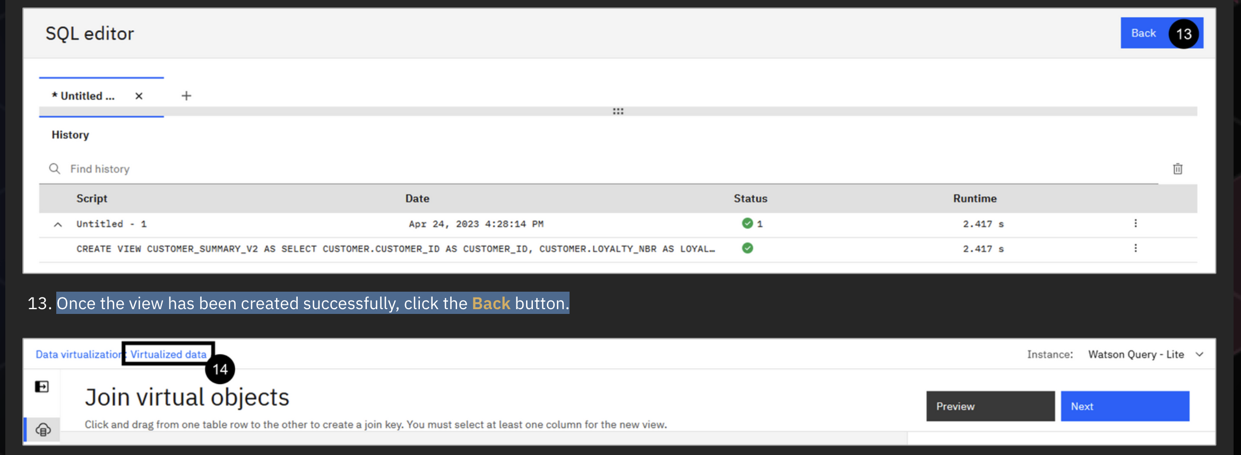
Create virtual views
Click the Format the statements in the editor (</>) button (in the middle of the tool bar above the SQL statement). This nicely formats the SQL statement.
Click Run all.
Once the view has been created successfully, click the Back button.

Slide 27
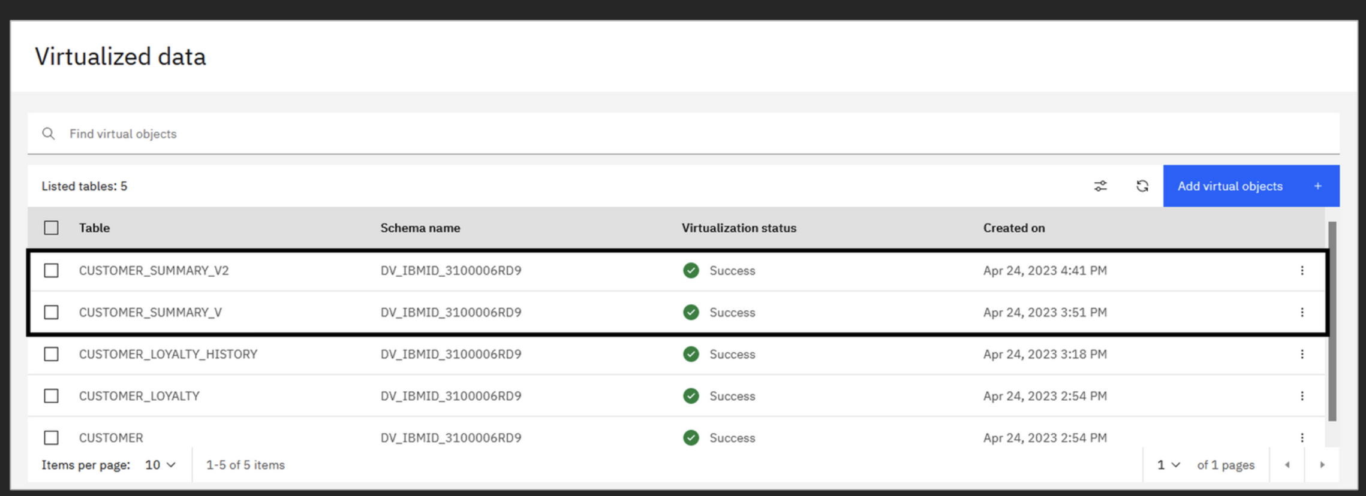
Explore virtual view
Click Virtualized data in the breadcrumb at the top of the screen
You should now see both the CUSTOMER_SUMMARY_V and the CUSTOMER_SUMMARY_V2 views in your list of virtualized data objects.

Slide 28
Manage access
Take a closer look at one of the views you just created:
Click the vertical ellipsis at the right side of the row for the CUSTOMER_SUMMARY_V view.
Notice all of the various things you can do with the view, such as viewing details about it (which includes previewing the data), managing access, and publishing the view to a catalog. Select View details to preview the data in the view.
Note: You may need to wait a few seconds for the rows to be displayed. The preview area will remain blank (showing "0 Columns" and "0 Rows") until the rows are loaded.

Slide 29
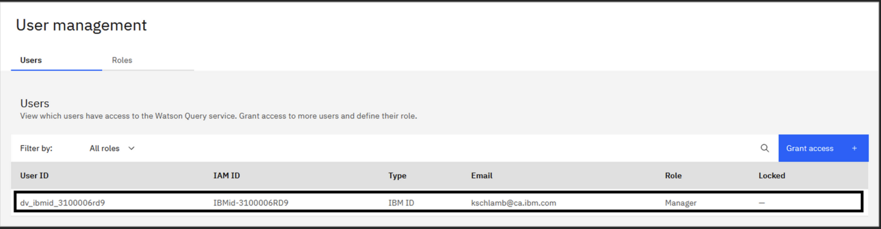
Manage access
Manage Access
Virtual objects can be accessed by applications through Watson Query. More specifically, an application can connect to Watson Query and issue queries against the objects that the application has access to (based on the user associated with the connection).
There are two levels of access control that need to be managed. First, at the Watson Query level – where users need to be added and assigned roles. Second, at the individual object level – where users are granted access to an object in order to view and query the data associated with it.
1. Select Administration > User management from the side menu. You should start in the Users tab by default.

Slide 30
Manage access
Make note of your user ID as you will need to use it later in this lab. Write it down or copy it into a document.
dv_ibmid_270006g705
There are four roles that can be assigned to users in the Watson Query environment:
Manager: Administrator of the environment and “super user” – able to perform all activities, including adding other users.
Engineer: Configures the data sources, virtualizes data, and manages access to virtual objects. Users with this role can create a virtual table or view and grant access to it to users with the Engineer or User role.
Steward: Can access data in all user tables and views. Unlike users with the Engineer role, a user with the Steward role cannot configure data sources or create virtual tables – but it can create virtual views on top of existing virtual tables and views.
User: Can create views on top of virtual tables and views to which they have been given access.

Slide 31
Manage access
To show the process of adding a regular user and managing access to virtual objects, you are going to add an existing IBM ID to the Watson Query environment. This is a user that was previously created for use within the Data and AI Live Demos environment. This user will be referred to as the business user going forward.
Click Grant access+ on the right.
Select User for the Role.
Click Create. This may take a minute or two to complete. Wait until it completes.
Accessing Virtual Objects:
Generally speaking, by default, virtual objects are only accessible by the user that created them (unless a user has a role that permits access to all of the objects created). Therefore, the customer-related virtual tables and the virtual views that you created earlier in this lab are only accessible by you, and not by the business user you just added. This business user must be explicitly granted access to the virtual objects you created.
Select Virtualization > Virtualized data from the side menu.
Check the box beside each of the objects in the table (or check the box in the table header to select all of them at once).
Click Manage access on the right.
When the Manage access to virtual objects window pops up, click Continue.

Slide 32
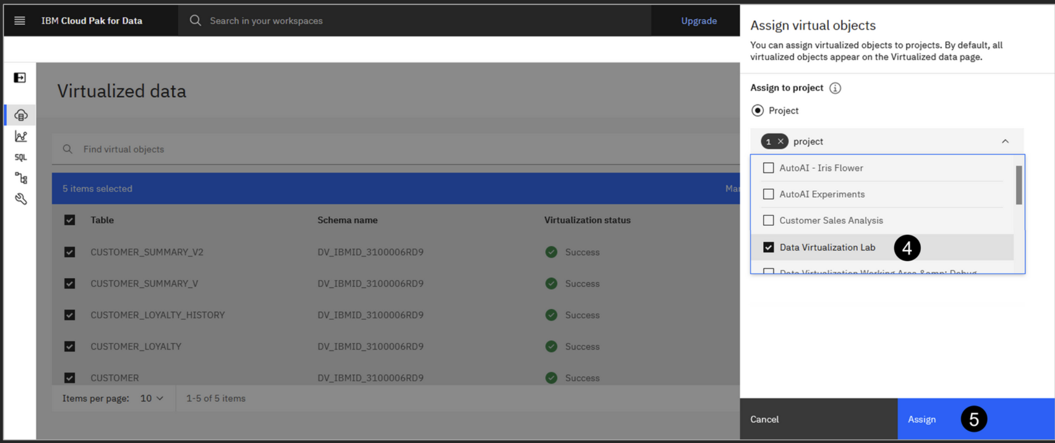
Assigning virtual objects to projects
Select Virtualization > Virtualized data from the side menu.
Check the box beside each of the objects in the table (or check the box in the table header to select all of them at once).
Click Assign on the right
In the Select a project dropdown menu, select the Data Virtualization Lab project you created earlier.
Click the Assign button. You will be returned to the Virtualized data screen.

Slide 33
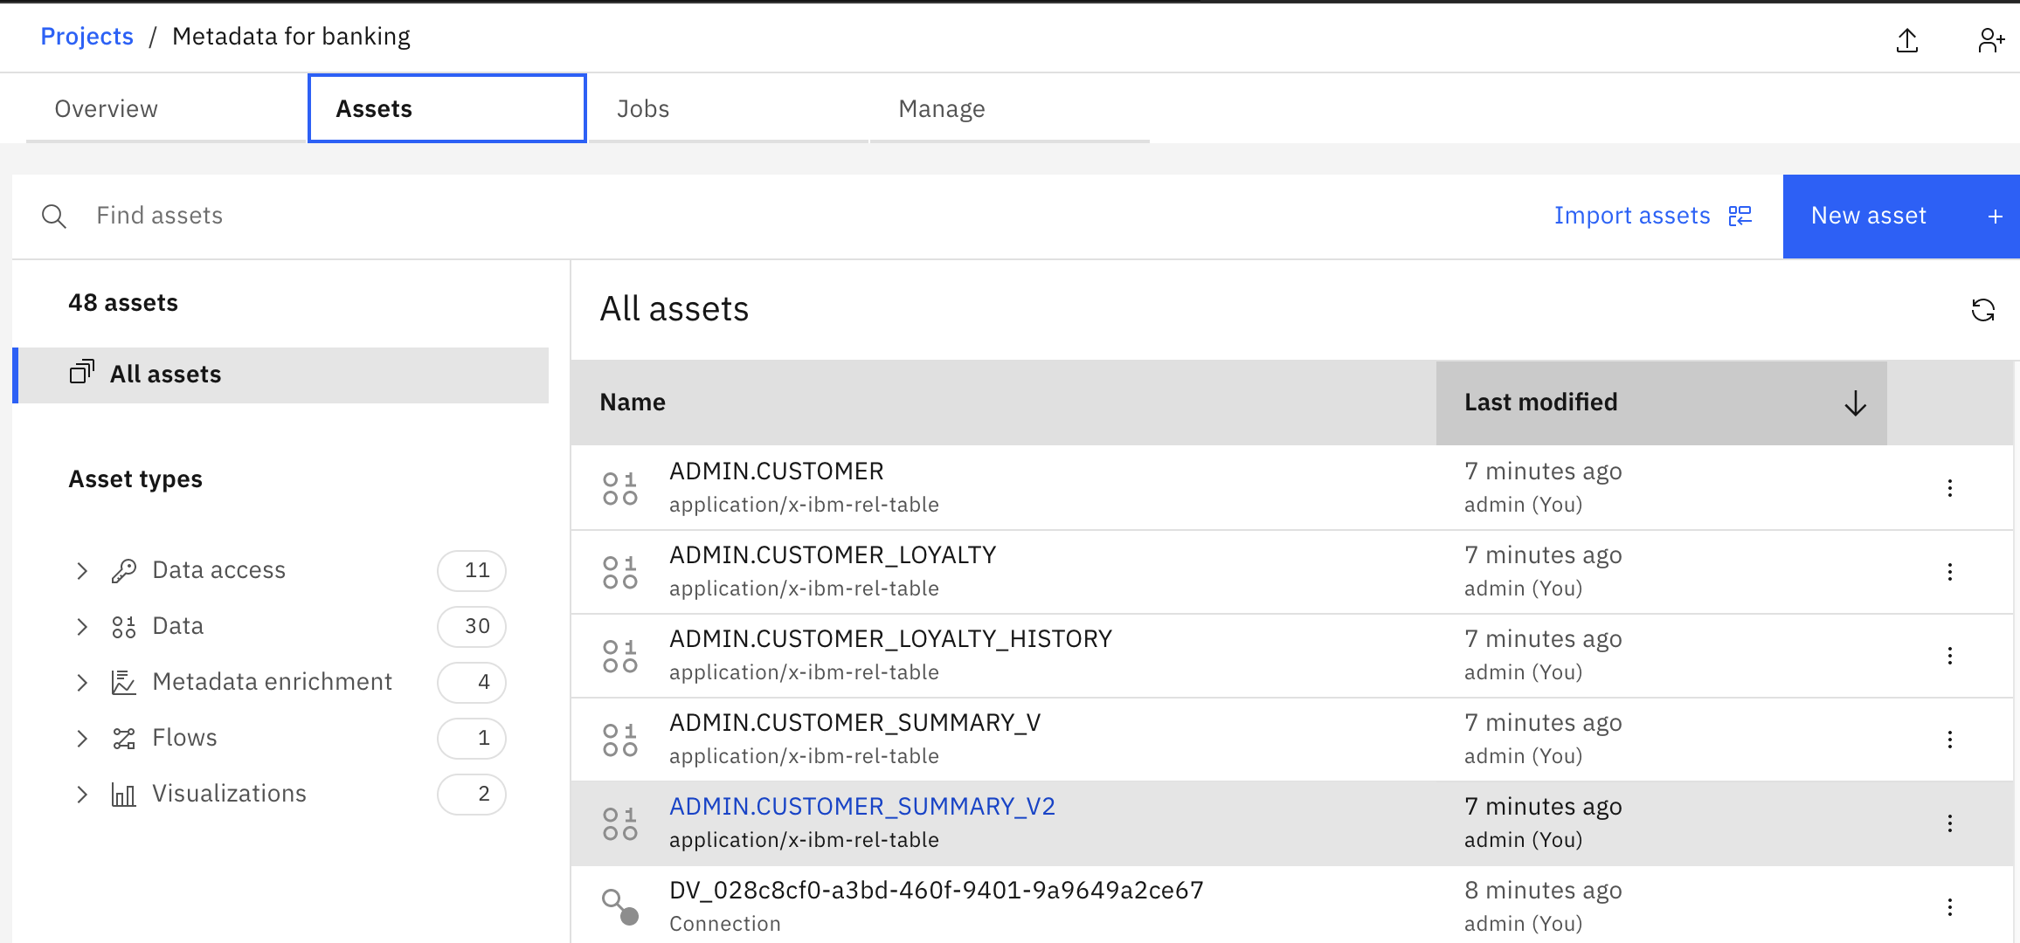
Assigning virtual objects to projects
You may see a green pop-up message stating that the job assigning the virtual view to your project was submitted successfully. Click the X at the right side of the message to dismiss it.
You will now go to the project to see the objects you just assigned to it.
Go to project – ‘metadata for banking’
Click the Navigation menu in the top left corner.
Select Projects > View all projects.
Click the Metadata for banking project name.
In your project, select the Assets tab.
Select All assets on the left (if not already selected).
Here you should see the five virtual objects assigned to your project, as well as a Connection asset that was created for you automatically (in addition to the notebook you created in the project earlier). You may be wondering what that connection asset is used for. Read on.

Slide 34
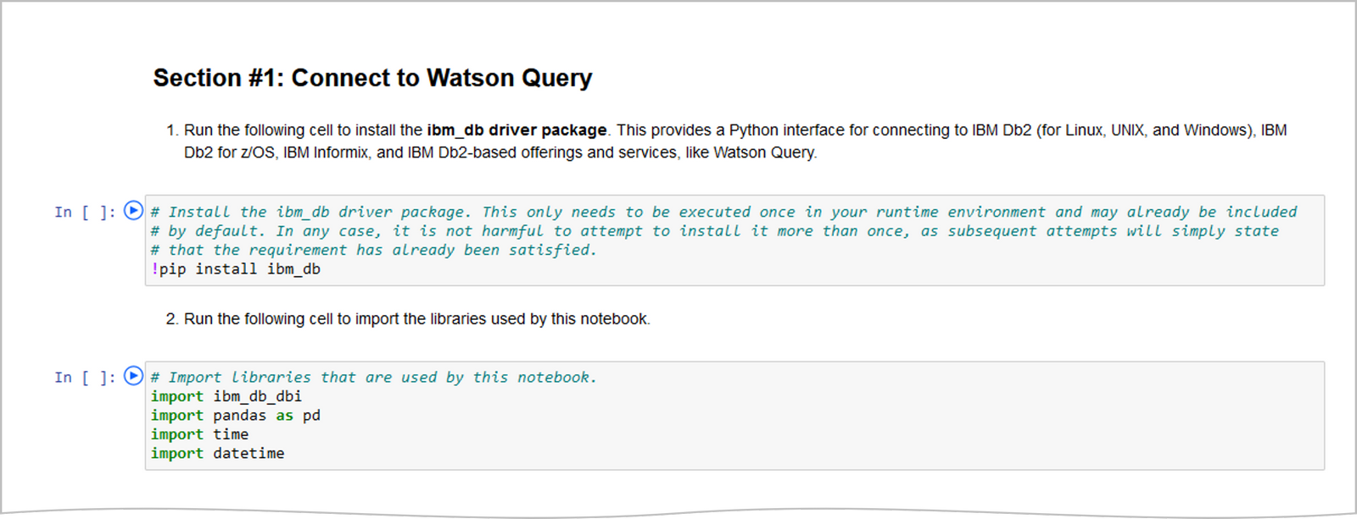
Data Virtualization
With respect to the contents of this notebook, Section #1 includes cells with code to import needed Python libraries, setup connection variables, connect to Watson Query, and run a query to verify the connection was successful

Slide 35
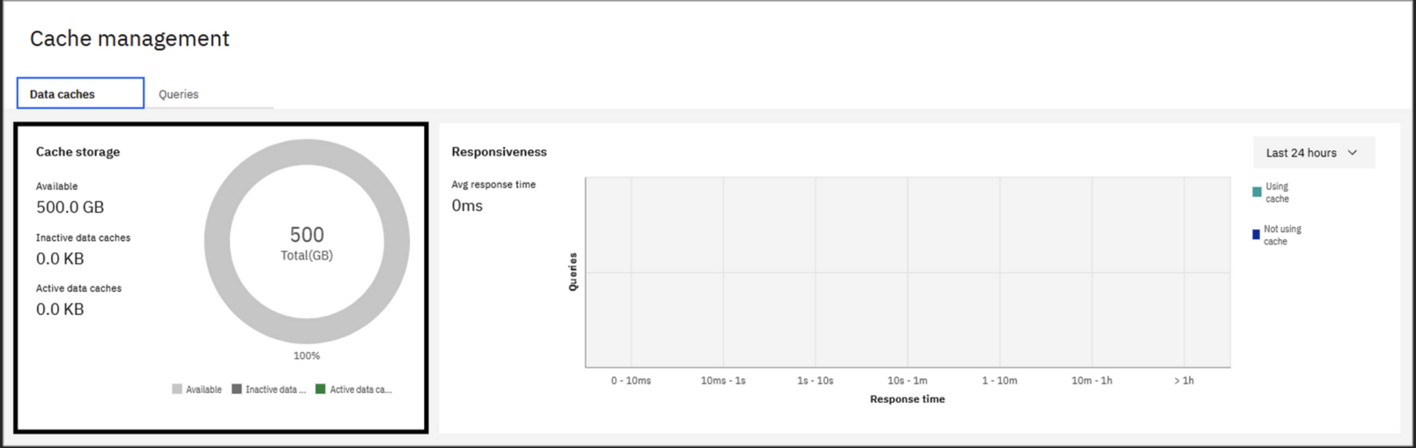
Data Caching
The primary capability of data virtualization in Watson Query is to virtualize data sources so that data can remain in-place while it is accessed through a single framework. However, as a way to improve query performance, a cache can be created locally to store query results. When subsequent queries are executed, the query engine will automatically determine whether data can be served from a cache rather than the base data source(s), resulting in improved query performance. In fact, Watson Query can recommend caches that would improve query performance, and even write the SQL to create them, based on query history. Caches can be refreshed frequently (every hour, for example) to ensure the cached data remains current.
Open a new browser window and log in to Cloud Pak for Data as a Service.
Click the Navigation (hamburger) icon in the upper-left corner and select Data > Data virtualization.
Select Virtualization > Cache management from the side menu. This option is only visible to users with the Manager role, which you have.

Slide 36
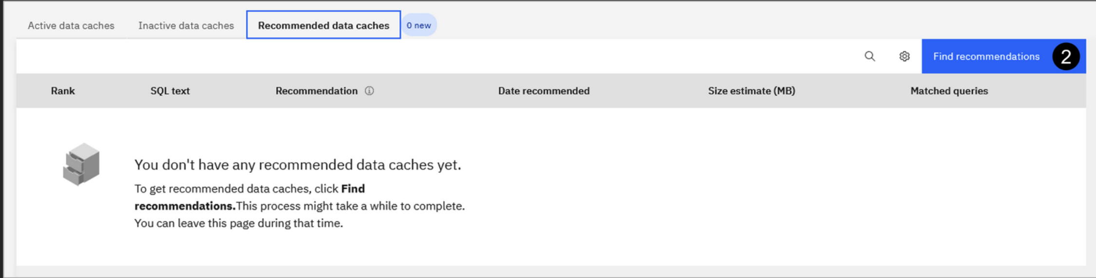
Data Caching
On the Cache management page you can create and manage data caches, as well as monitor the storage utilization and responsiveness of your caches.
Cache storage information is visible in the upper-left portion of the screen. This includes the amount of storage used for both active and inactive caches. Query optimization considers only active caches for improving the performance of queries. Inactive caches are caches that have been deactivated and can't be used for query optimization.
The upper-right portion of the screen shows query responsiveness. Here you can monitor how many queries ran in a specific execution time period. You can also compare the responsiveness of queries that use data caches and queries that do not use data caches.
Active data caches can be viewed and managed in the Active data caches tab at the bottom of the screen. Caches that have been deactivated are listed in the Inactive data caches tab. Cache recommendations made by Watson Query can be found in the Recommended data caches tab.
Select the Recommended data caches tab.

Slide 37
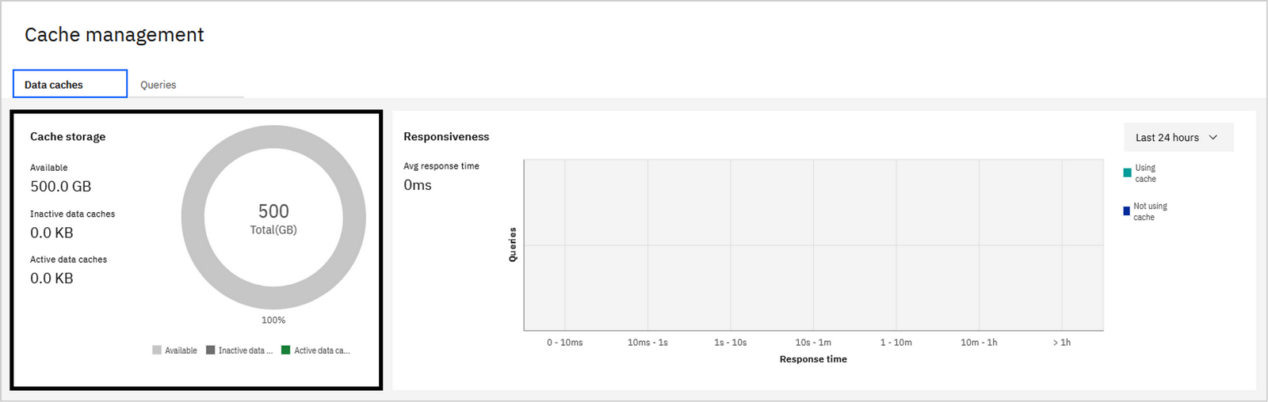
Intelligent caching
To improve query performance:
- Cache can be created locally to store query results. - query engine will automatically determine whether data can be served from a cache rather than the base data source(s), resulting in improved query performance. - Watson Query can recommend caches that would improve query performance, and even write the SQL to create them, based on query history. - Caches can be refreshed frequently (every hour, for example) to ensure the cached data remains current. - On the Cache management page you can create and manage data caches, as well as monitor the storage utilization and responsiveness of your caches. - Cache storage information is visible in the upper-left portion of the screen. This includes the amount of storage used for both active and inactive caches. Query optimization considers only active caches for improving the performance of queries. Inactive caches are caches that have been deactivated and can't be used for query optimization.

Slide 38
Cache Management
The upper-right portion of the screen shows query responsiveness. Here you can monitor how many queries ran in a specific execution time period. You can also compare the responsiveness of queries that use data caches and queries that do not use data caches.
Active data caches can be viewed and managed in the Active data caches tab at the bottom of the screen. Caches that have been deactivated are listed in the Inactive data caches tab. Cache recommendations made by Watson Query can be found in the Recommended data caches tab.
Select the Recommended data caches tab.
Click the Find recommendations button.
When warned that new recommendations will replace existing recommendations, click Continue.
The cache recommendation engine uses two models to generate recommendations. The rule-based model uses sophisticated heuristics to determine which cache candidates help the input query workload. The machine learning-based model uses a pre-trained machine learning model that detects underlying query patterns and predicts caches that could help a potential future query workload.
The cache recommendation engine uses two models to generate recommendations. The rule-based model uses sophisticated heuristics to determine which cache candidates help the input query workload. The machine learning-based model uses a pre-trained machine learning model that detects underlying query patterns and predicts caches that could help a potential future query workload.
Both models produce a ranked list of cache candidates that are consolidated by the engine to generate a final set of recommendations.
In addition to cache creation recommendations, the engine may also recommend disabling and deleting caches based on past usage and other metrics. These recommendations appear in the active and inactive caches tabs for existing caches.
The recommendation engine works in the background, allowing you to navigate to another screen and come back later. However, because you haven't executed a query workload yet, there are not enough input queries to analyze and make recommendations from. Therefore, the recommendation table is likely to be empty at this point.
Let's run a query workload so that actual recommendations can be made..

Slide 39
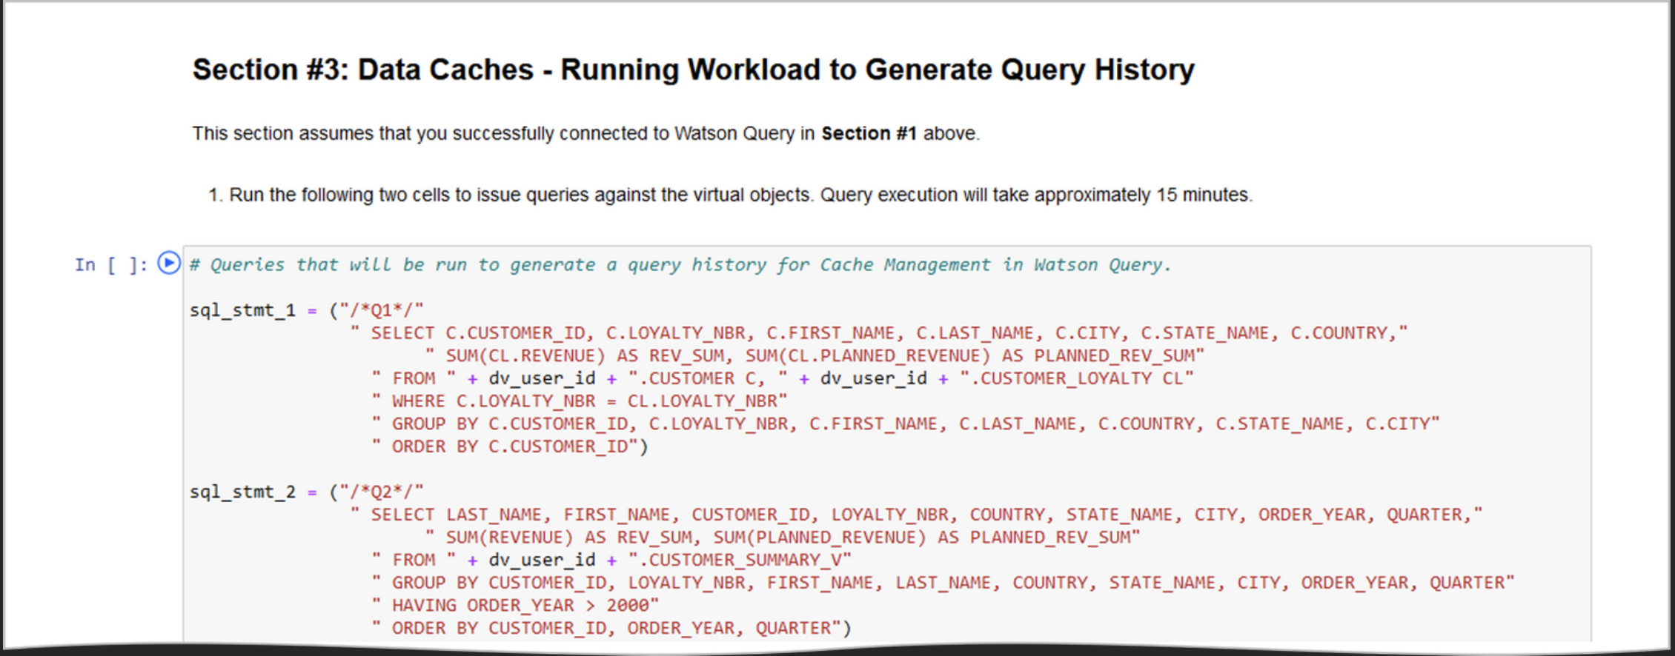
Run Query workload
You will now run a query workload against Watson Query using the same Jupyter notebook you used earlier. Recall that you previously completed the work in Section 1 and Section 2 and your notebook still has a connection to the Watson Query service:
Switch to the browser window where you currently have the Data Virtualization Lab Notebook running.

Slide 40
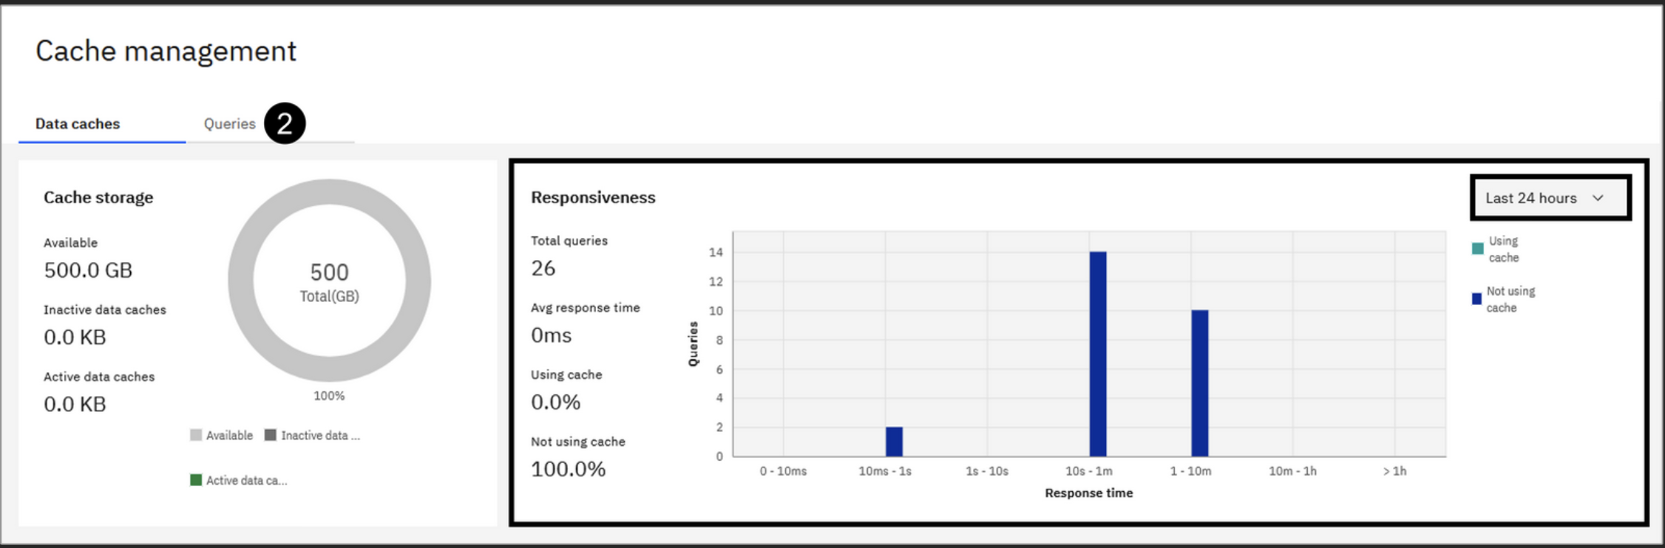
Run Query workload
Follow the instructions in Section #3 to run a series of complex queries against your virtual objects.
Once all of the queries have finished running, wait at least five minutes before proceeding. This should allow the captured queries to be pulled into Watson Query's metastore (which is where the cache management panel and the recommendation engine get query information). The default collection interval time is five minutes.
You no longer require this notebook after this point and can close the browser window (or tab) if you like.
Generate Cache Recommendations
Now that you've issued a number of queries against Watson Query, check to see if there are any data cache recommendations based on that workload.
Select Virtualization > Cache management from the side menu.

Slide 41
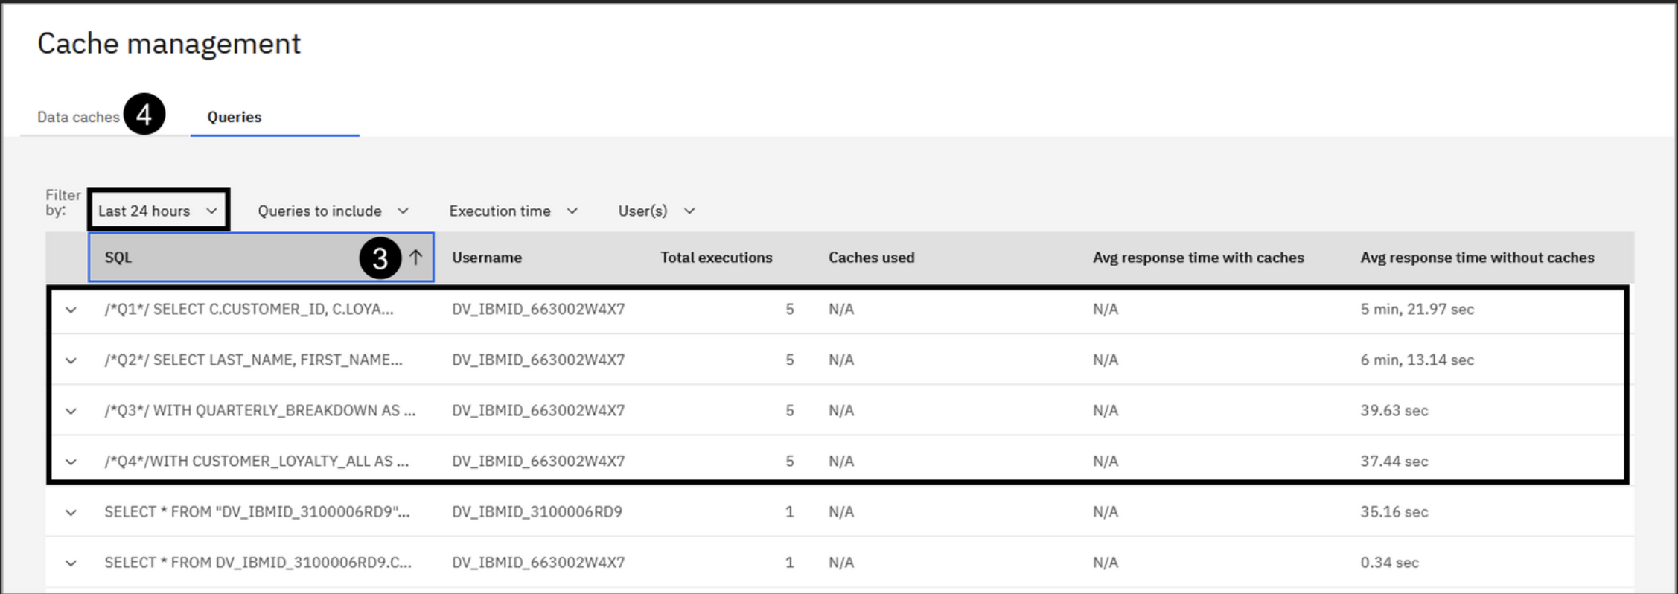
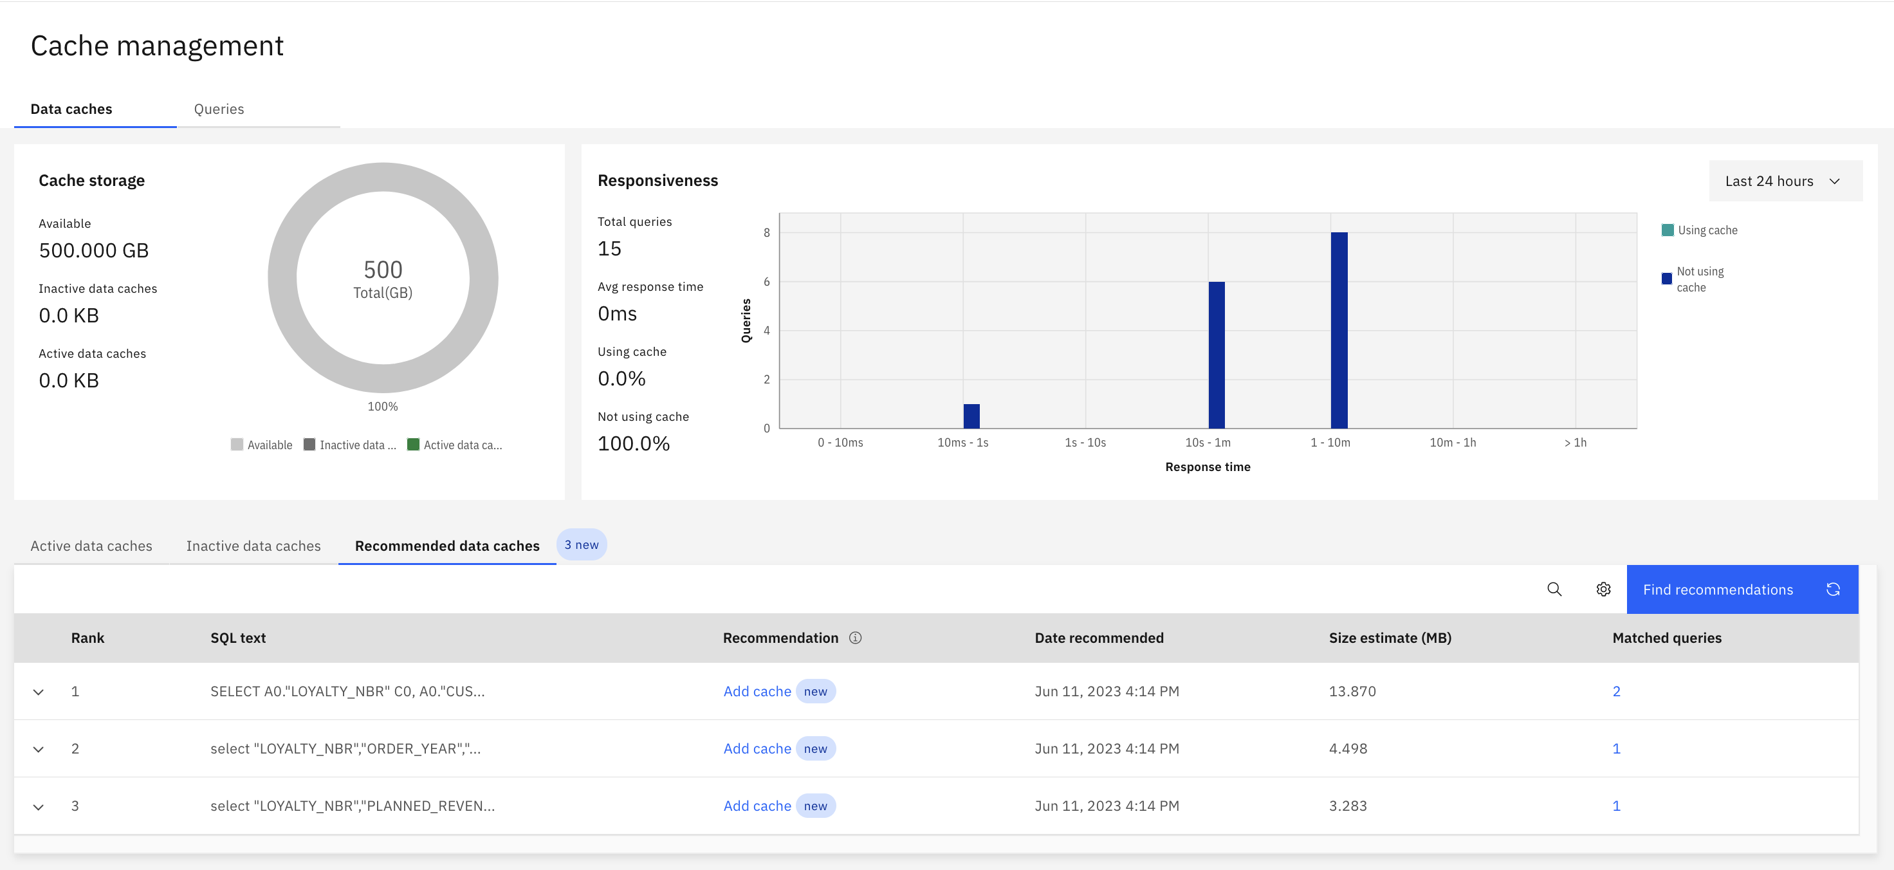
Run Query workload
Select the Queries tab.
Click the SQL header once to sort the list.
The queries you ran in the Jupyter notebook should all be listed, along with the number of times each query was executed and the average response time. You should see queries with /*Q1*/, /*Q2*/, /*Q3*/, and /*Q4*/ in the SQL text, with five total executions each. If you do not see this, or you only see a portion of the statement executions, then the query details haven't been fully extracted into Watson Query's metastore yet. As suggested above, wait a few minutes and refresh the page (similarly, you can toggle the table filter between Last 7 days and Last 24 hours).
Note: There is currently an issue in Watson Query with the average response time sometimes being reported incorrectly (the product development team is aware). The individual queries in your query workload did not actually take minutes to run as it might show for you.
Select the Data caches tab.

Slide 42
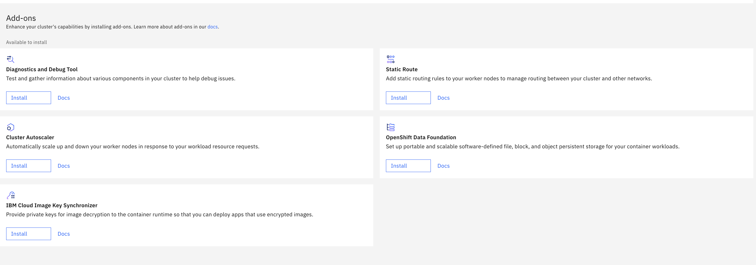
Automatically scaling resources for services
Some IBM Cloud Pak® for Data services support autoscaling by using the Red Hat® OpenShift® Horizontal Pod Autoscaler (HPA).
https://www.ibm.com/docs/en/cloud-paks/cp-data/4.6.x?topic=services-automatically-scaling
SPSS Modeller:
cpd-cli manage update-cr \ --component=productmaster \ --cpd_instance_ns=${PROJECT_CPD_INSTANCE} \ --patch='{\"autoScaleConfig\":\"true\"}'
cpd-cli manage update-cr \ --component=productmaster \ --cpd_instance_ns=${PROJECT_CPD_INSTANCE} \ --patch='{\"autoScaleConfig\":\"false\"}'

Slide 43
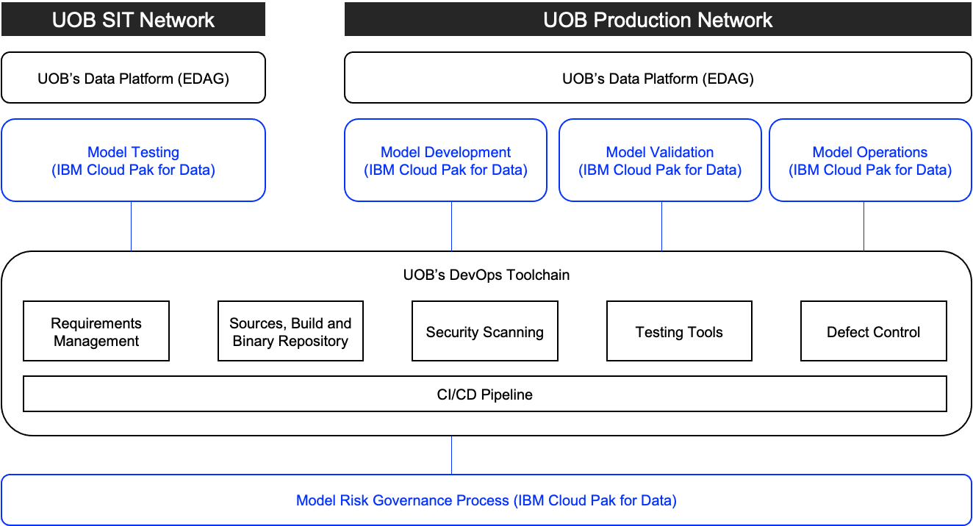
B1.5, B1.5.1, B1.5.2: Development Architecture (Toolchain Integration)
The solution provides out of box integration with Source Repositories such as GitHub, GitHub Enterprise, GitLab, GitLab Self-Managed, BitBucket, BitBucket Enterprise, Azure DevOps Services
Integration with other UOB’s DevOps Toolchain will be via various APIs provided by Cloud Pak for Data

Slide 44
Storage details

Slide 45
What is Data Lineage?
The process of tracking how data is moved, transformed, and consumed across disparate tools and sources.
Notes:
So what is data lineage?
Data Lineage is the process of tracking data. How data is moved, transformed, and consumed across an organization.

Slide 46
Data Lineage Users
Business Data Lineage: Business Terms and Quality Score
Technical Data Lineage: Precision, Data Type, Historical Lineage and Indirect Lineage
Type of User | Business Use | Technical Use
Data Engineer | No | Yes
Data Scientist | Yes | Yes
Business User | Yes | No
Notes:
2 Types of Data Lineage: to understand the asset with more context from a business or technical perspective.
Business Data Lineage: Augmented with business terms, classifications, and quality score
Technical Data Lineage: Augmented with data type, historical/indirect lineage
This is important as there are different users, and you can see how they have different needs.
For data engineers, the technical data lineage helps ensures data integrity, and facilitates troubleshooting and optimization of ETL flows.
For data scientists, the business and technical data lineage supports data validation for model building.
For business users, the business data lineage provides transparency and confidence in data used for analytical reports for example.

Slide 47
How does Business Data Lineage work?
Notes:
So how can we tackle these challenges with data lineage? I will be going through how data lineage works to show you where your data has come from, how it has changed, and who is using it.

Slide 48
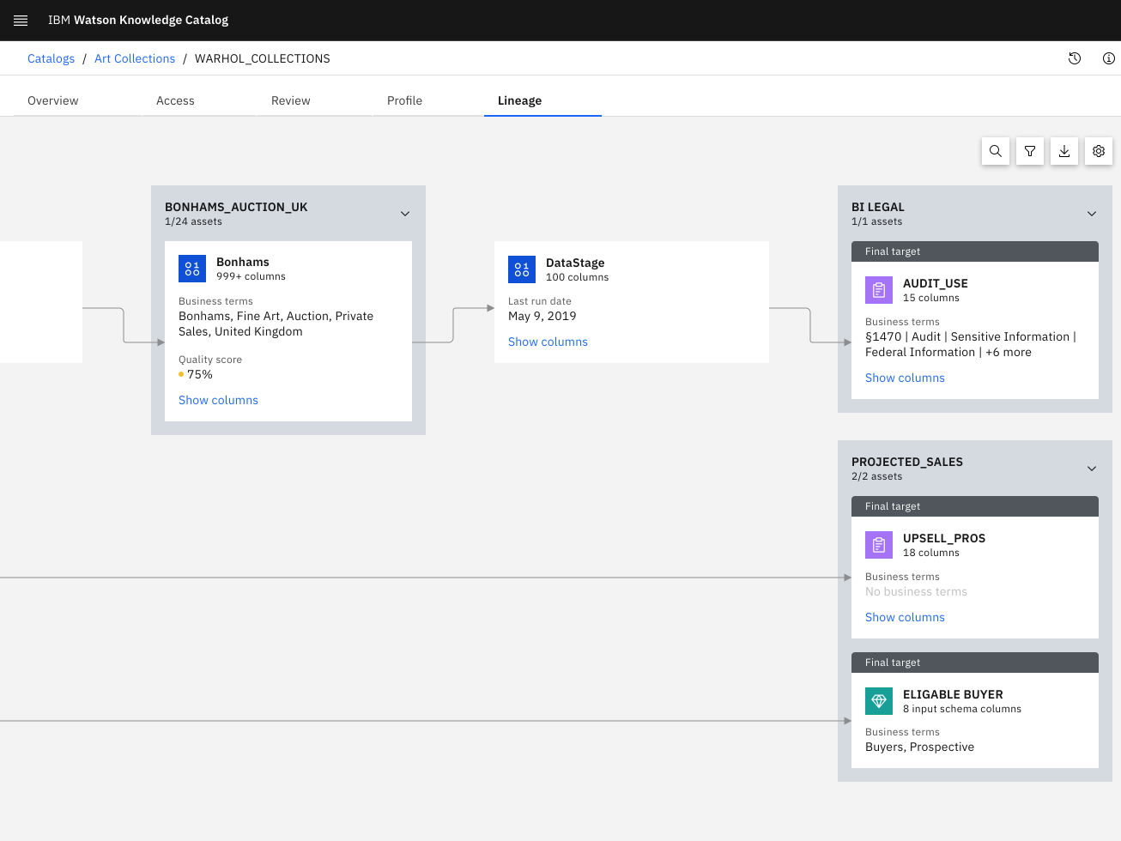
Business Data Lineage
Cloud Pak for Data’s native lineage
Business-user-friendly summary view of technical data lineage
Drill down to view technical details
Manual lineage through APIs
Notes:
The lineage view is available natively on CP4D when clicking on the asset in a governed catalog.
Targeted toward business users, the UI populates a summary lineage view with different information from metadata enrichment such as the data quality and business terms.
On the right, you can see the lineage view you get with WKC. We can see the links between the columns from the source, through the transformation, and at the target.
The information tab will bring up key information for business users, such as the asset’s description, owner, data quality, and other details like the type of asset.
Here you can directly drill down to technical lineage details provided by MANTA which I will be going through next. Tracking is through the CP4D WKC API.

Slide 49
How does Technical Data Lineage work?

Slide 50
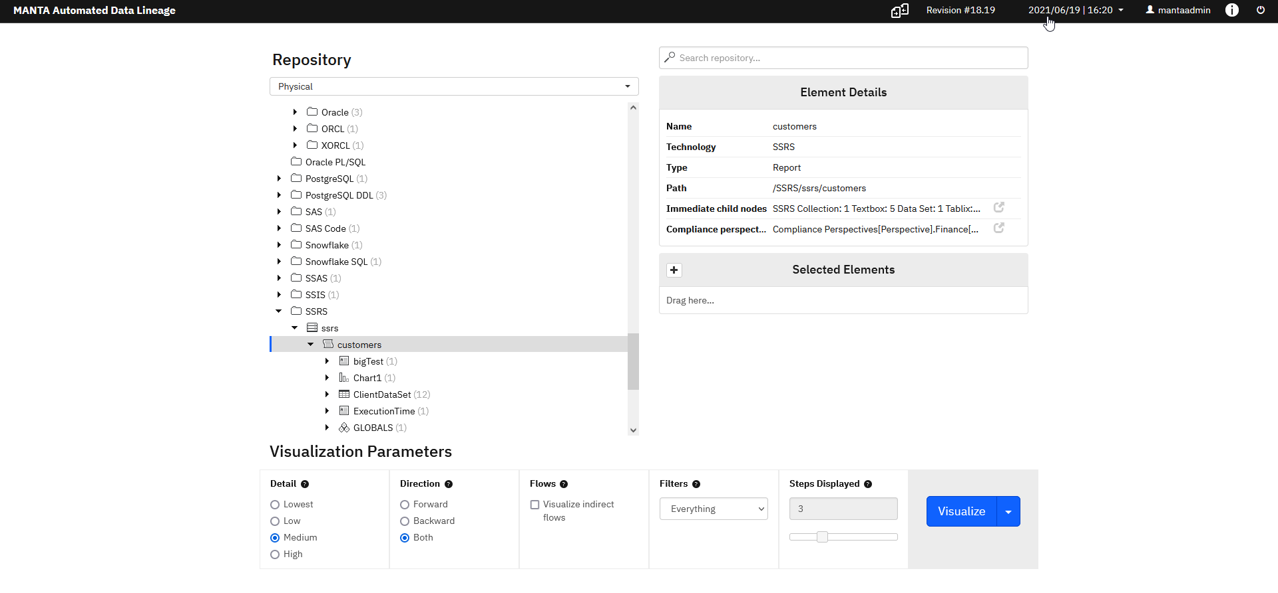
Technical Data Lineage
Visualize lineage within WKC along with Data Quality, Data Owner and other metadata
Automated discovery of data flows from 3rd party tools
Code analysis of stored procedure and ETL jobs to capture transformations
Advanced manual lineage
Powerful filtering rules within lineage graph
Technical Data Lineage GUI
Historical Data Lineage
Indirect Data Lineage
Notes:
As mentioned previously, we can drill down to MANTA for technical details directly from WKC.
MANTA introduces features more catered toward technical users, with more filtering capabilities and technical information in the Data Lineage graphical user interface.
Their automated scanners for automated data flow discovery and code analysis help save time with lineage tracking.
What does technical data lineage mean? I will be going through some of the features later but briefly, we have:
There is a historical lineage, you can compare the state of the environment or dataflows live at any selected point in time.
There is also indirect lineage, you can analyze how one data element influences another one even without a direct data lineage connection. For example, a database column is used as a filtering condition for data presented in a report.

Slide 51
Data Lineage Components
Business Data Lineage
For business users
Easy-to-consume business data lineage
Technical Data Lineage
For technical users
Detailed data lineage
Automated discovery of data flows in 3rd party tools (e.g., Power BI and Tableau)
Integration with WKC
Notes:
So far, we have gone through business data lineage with WKC and Technical Data Lineage with MANTA.
These are two components to Data Lineage.
First, we have the WKC Business Data Lineage.
This is a high-performance summary view of technical data lineage for business users to easily consume
Next, we have MANTA Technical Data Lineage.
This is for technical users to view more detailed technical, indirect, and historical data lineage.
MANTA scanners which allow automated discovery of data flows mean cost and time savings due to reduced lineage tracking efforts.
Furthermore, the integration with WKC means discovered assets through scanners are fed directly into WKC Business Data Lineage UI.

Slide 52
Out-of-the-Box Scanners
Databases
Yellowbrick
Amazon RDS for PostgreSQL
Amazon Redshift
Amazon Aurora
Google Big Query
Snowflake
Greenplum
Hive (Apache)
IBM Db2
Microsoft Azure SQL Data Warehouse
Microsoft Azure SQL Managed Instance
Microsoft SQL Server Database
Netezza
PostgreSQL
SAP ASE (Sybase)
SAP Hana
Teradata Database
Oracle
Amazon S3
Data integration
Apache Kafka
Infosphere DataStage (4.7)
Informatica Power Center
Microsoft SQL Server Integration Services
Oracle Data Integrator
Pig
Sqoop
StreamSets
Talend
Azure Data Factory
Next Gen DataStage (4.7)
Fivetran
DBT
Reporting & Analysis
Qlik Sense
IBM Cognos Analytics
Microsoft Excel
Microsoft SQL Analytics Platform System
Microsoft SQL Server Analysis Services
Microsoft SQL Server Reporting Services
MicroStrategy (Coming Q4 2023)
Oracle Business Intelligence (OBIEE)
Power BI
SAP Business Objects
SAS
Tableau
Programming languages
COBOL
Modeling
ER/Studio
Erwin Data Modeler
SAP Power Designer
Legend:
Relevant For ITS Project
Notes:
Here are the supported MANTA scanners OOTB.
Those highlighted are the scanners supported for integration with WKC and we are constantly updating the list.
So, with two different flows and types of lineage (business and technical), what does this mean for lineage tracking?

Slide 53
Value Proposition Data lineage is a critical capability for Data Fabric use cases
Regulatory Compliance
Financial regulations (e.g., BCBS 239)
Industry regulations (e.g., PDPA, GDPR, CCPA)
Trust in the data used for analytics and AI
Impact analysis
Assess how changes will affect downstream consumption
Root cause analysis
Diagnosing issues and discrepancies in data and reports
Assessing the reproducibility of reports and models
Capture of business processes across the organization
Notes:
Data Lineage helps with some of the challenges mentioned in the previous slide.
Firstly, it helps with traceability: where does an asset originate and how did it change over time
Regulatory Compliance: Identify the origins of sensitive data, the various locations where it’s stored, and who can access it
Deliver Trustworthy Data for Analytics and AI: Show data’s journey clearly for everyone in the organization
Impact Analysis: Rapidly make an assessment and know whether and what downstream impact a change to an asset might have before you make any changes.
Root cause Analysis: you might want to see where a specific asset came from and how it impacted other assets.
Migrate to a New Architecture: Scan to-be-modernized systems to identify dependencies and make clearer what needs to be migrated and what can be ignored

Slide 54
Data Lineage User Flow
Business Lineage
Technical Lineage
Notes:
Next, I will be going through the user flow for data lineage.
First with WKC, MANTA, then with WKC and MANTA.

